Slide 1
Data Sources
FRED API
https://fred.stlouisfed.org/docs/api/fred/
Historical Unemployment
Historical Manufacturing Employment
Historical Housing Starts
OECD
https://data.oecd.org/leadind/consumer-confidence-index-cci.htm
Historical Consumer Confidence Index
MacroTrends
https://www.macrotrends.net/2015/fed-funds-rate-historical-chart
Historical Fed Funds Rate
US Inflation Calculator
https://www.usinflationcalculator.com/inflation/historical-inflation-rates/
Historical Inflation Rates

Slide 2
Build Map
Phase I (Minimum Viable Product)
Build model that will select indexes based on winners of the previous time period.
Phase II
Build model that will select weighted portfolios made up of the 3 indexes based on winners of the previous time period.
Phase III
Build model that will select weighted portfolios based on Fed Rates, Inflation, and Unemployment.
Phase IV
Build model that will select weighted portfolios based on chosen leading indicators.
Manufacturing Employment, Housing Starts, Consumer Confidence Index

Slide 3
Assumptions
Equity, Long Only only portfolios
Investors are not tax-exempt
Losses may be harvested.
Capital Gains may be taxed.
All asset allocation done via purchase/sale of ETF Index Funds
Trading is not free.
Risk Free Rate is 0

Slide 4
Model Interval Considerations
I considered four time intervals for my models.
Monthly
Quarterly
Semi-Yearly
Yearly
Monthly and Yearly were immediately eliminated:
Monthly
Monthly trades would likely resort in many unnecessary trade fees.
If losses are harvested, I want to avoid the possibility of Wash Sales.
Yearly
I believe yearly is too long to consider changes for an active strategy.
A yearly time period would fit a buy and hold strategy with a fixed portfolio allocation.
At least check once yearly to rebalance.

Slide 5
Model Interval Considerations - Choice
I chose a Quarterly interval for my models.
I believed this would allow me to avoid the drawbacks of monthly and yearly returns, while also allowing me to catch more of the shorter trends that occur over the time period that might be missed semi-yearly.

Slide 6
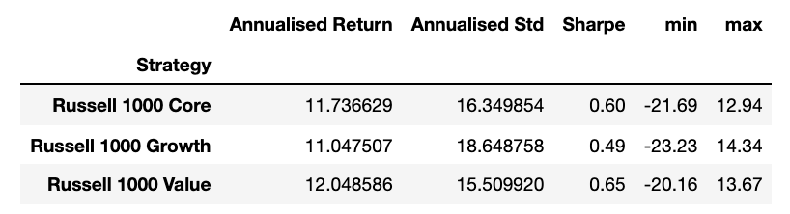
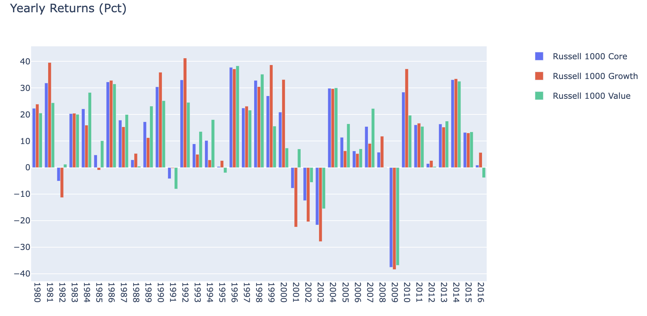
Initial Stats
Notes:
Russell 1000 Core provides middle of the pack returns, at middle of the pack risk.
Russell 1000 Growth, while responsible for the greatest single monthly returns, also has the lowest. It is a very risky index with the lowest returns on both a risk adjusted, and non-risk adjusted basis.
Russell 1000 Value provides the best returns and risk adjusted returns over the time period. It does not have returns as high as growth but appears to be more stable.
These indexes appear to be relatively highly correlated.

Slide 7
Notes
Trades occurs at the beginning of the quarter, based on last quarters data.
Each quarter’s selection is on the same row as it’s return.
For diagrams, a green box represents a starting point, while a red box represents an end point. Everything in between will be yellow.
Calculations are in blue boxes.

Slide 8
Momentum - Pure Index Strategy
The Strategy:
This model looks back one period (quarter), determines which index had the highest return, and invests in that index for the current quarter.

Slide 9
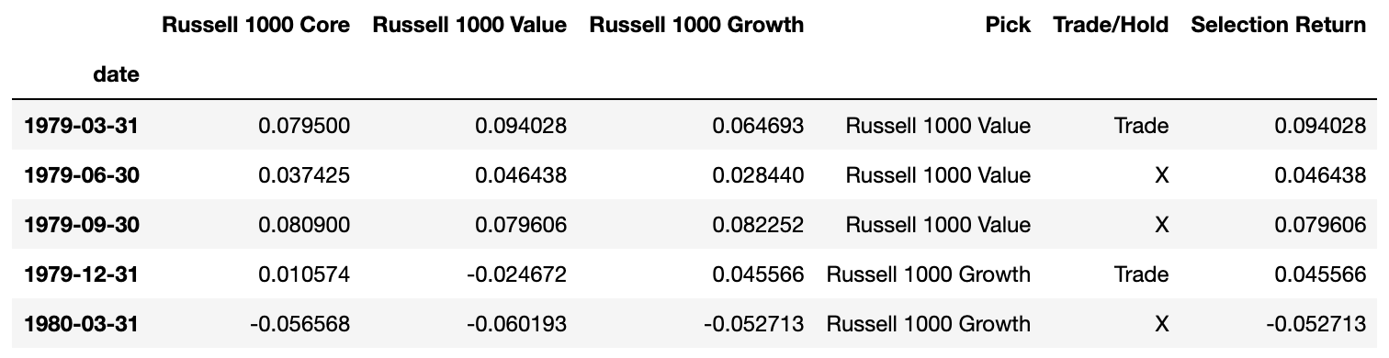
Momentum – Pure Index Overview
The quarterly returns of each index are shown under their respective names.
The Pick column contains the name of the index with the highest return in the last period.
I defaulted the first pick to the Russell 1000 Value.
The Trade/Hold column is a flag, which checks the previous month’s pick.
If it is not the same as the current month pick, a Trade flag is created.
The selection return column pulls the current quarter’s return from the same row based on the pick column.

Slide 10
Momentum – Pure Index Overview
This is a flow diagram showing how the model chooses its investments and the selection return values are reached.

Slide 11
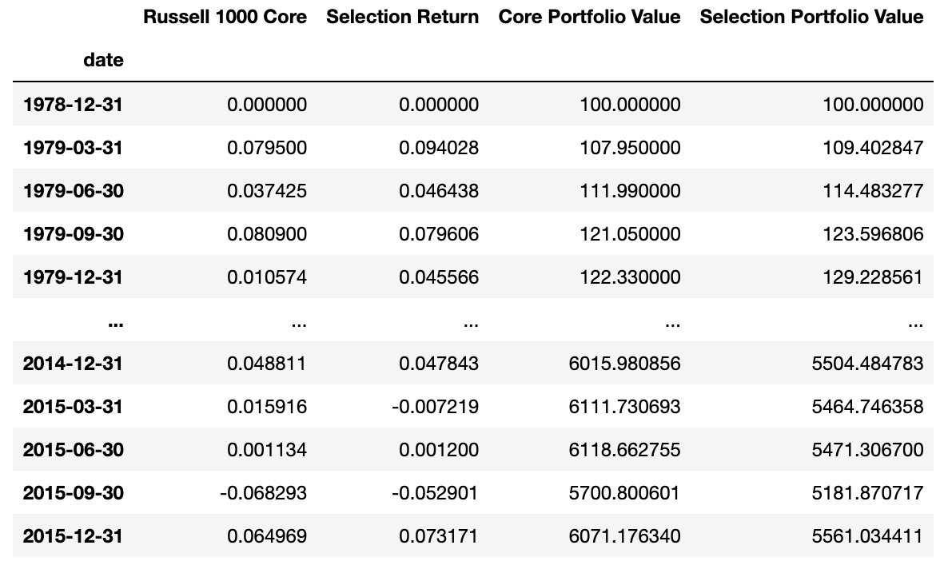
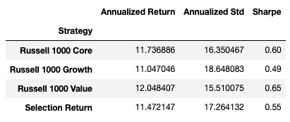
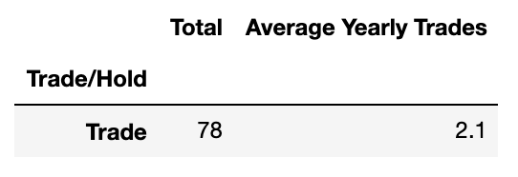
Momentum Pure Index Stats
Here I have provided a tabular representation of the strategy’s results. Including Annualized Return, Standard Deviation, Sharpe Ratio, Total trades over period, and average number of trades per year.

Slide 12
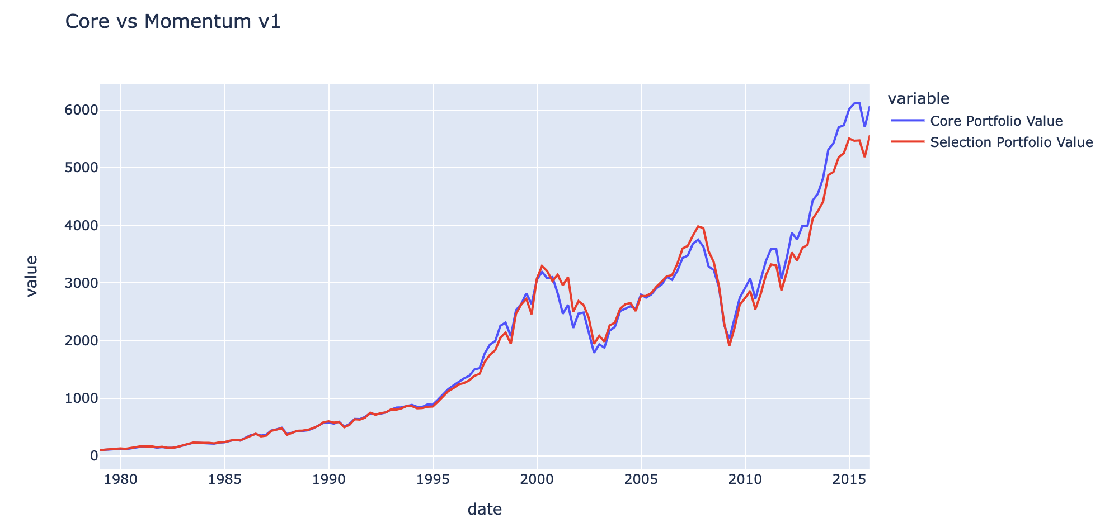
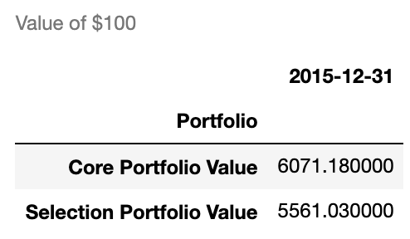
Core vs Pure Index Momentum Strategy
Here, I have provided a line plot comparing the value of $100 for a portfolio that held the Russell 1000 Core over the period, and a portfolio holding the strategy’s selected index.

Slide 13
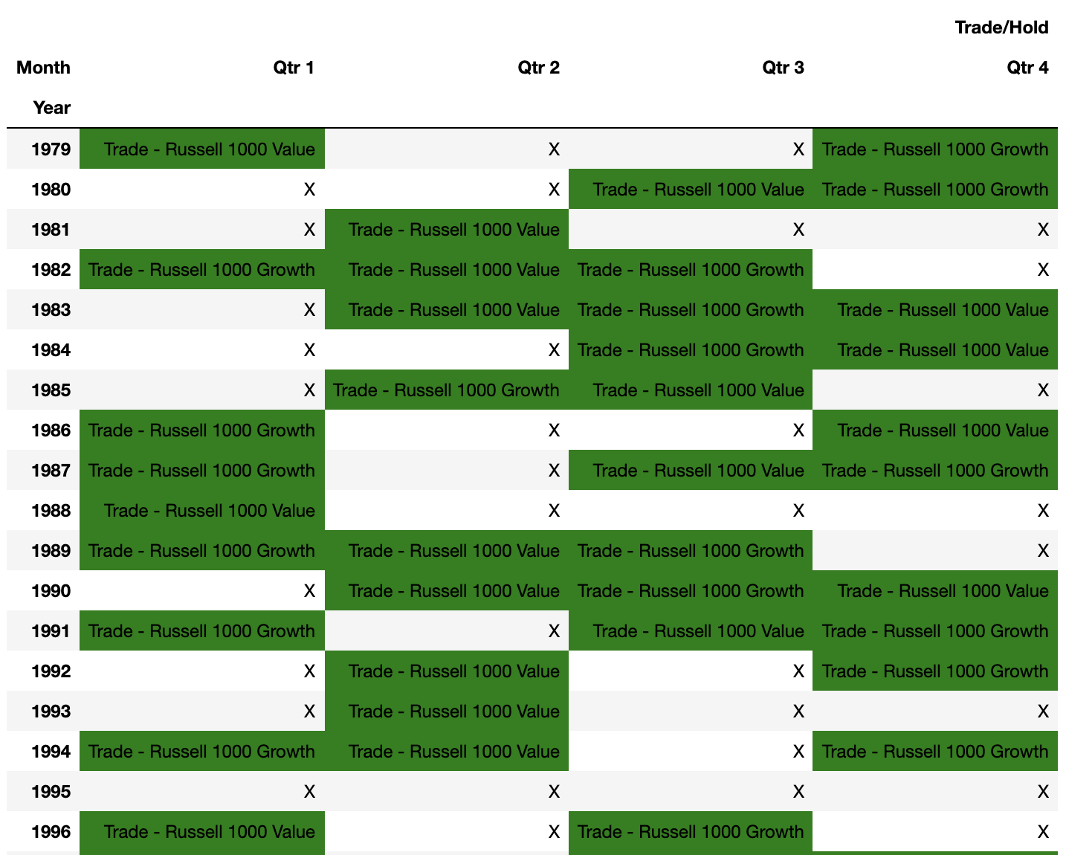
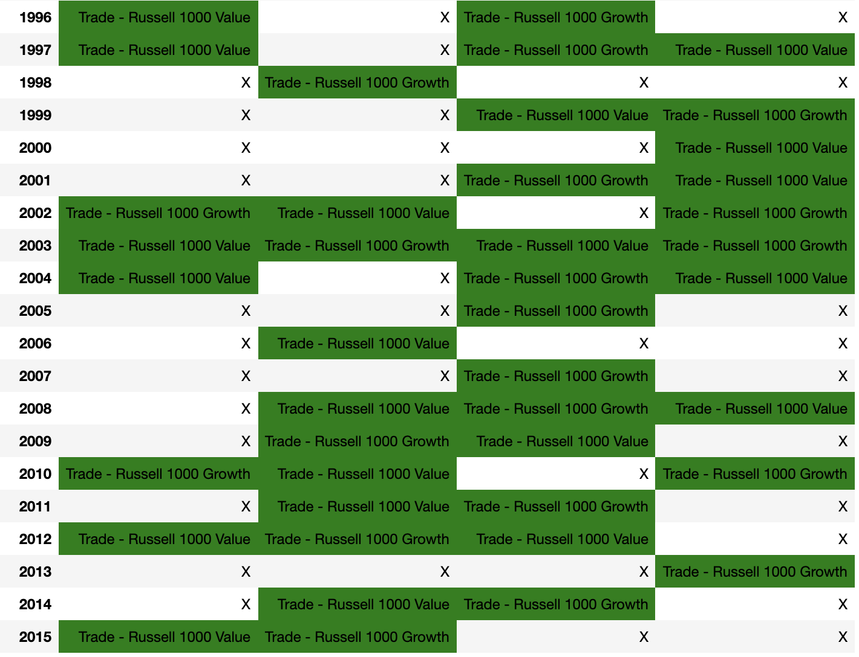
Momentum – Pure Index Trade Schedule
This is a visual representation of when trades would occur over the period. Years are along the left side, with quarters across the top. Along with a “Trade” flag, it shows which index should be invested in at the beginning of each quarter. These cells are shaded green. If no trade is to occur, the cell only contains the letter “X”

Slide 14
Momentum Pure Index - Summary
This strategy fails to beat the Russell 1000 Core.
As shown on slide 10, the strategy resulted in lower returns, with higher risk, resulting in a lower Sharpe Ratio.
The Momentum strategy resulted in a portfolio value of $5561 vs the Core portfolio value of $6119, a loss of about $558.
This does not include any expenses from the 78 trades over the period which would make the loss even more pronounced.
Using individual indexes appears to be too risky. Perhaps diversification will help.
If the pick is wrong, it is not unlikely that there is a considerable negative spike over the next quarter.

Slide 15
Momentum 2 – Weighted Index – Strategy
The Strategy:
This model looks back one period(quarter), determines which index had the highest return, and invests in a weighted portfolio based on the favored index for the current quarter.

Slide 16
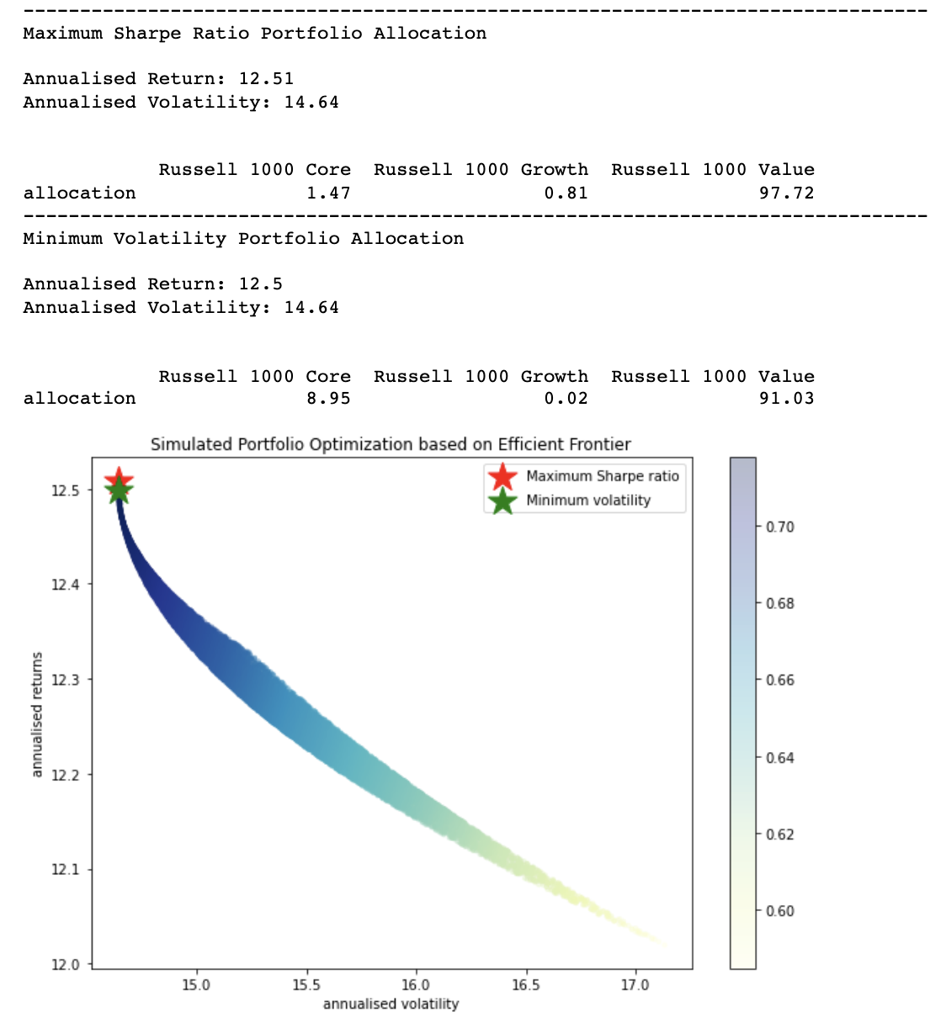
Efficient Frontier
I decided to find the efficient frontier to determine the best portfolio over the period.
Based on what I found, I decided to create three portfolios.
Each portfolio will overweight Value, as it has both the best returns and risk over the period.
Growth and Core will be weighted according to the favored style selection.

Slide 17
Define Portfolios
Value Weighted
97% Value, 2% Core, 1% Growth
Growth Weighted
70% Value, 20% Growth, 10% Core
Core Weighted
80% Value, 20% Core

Slide 18
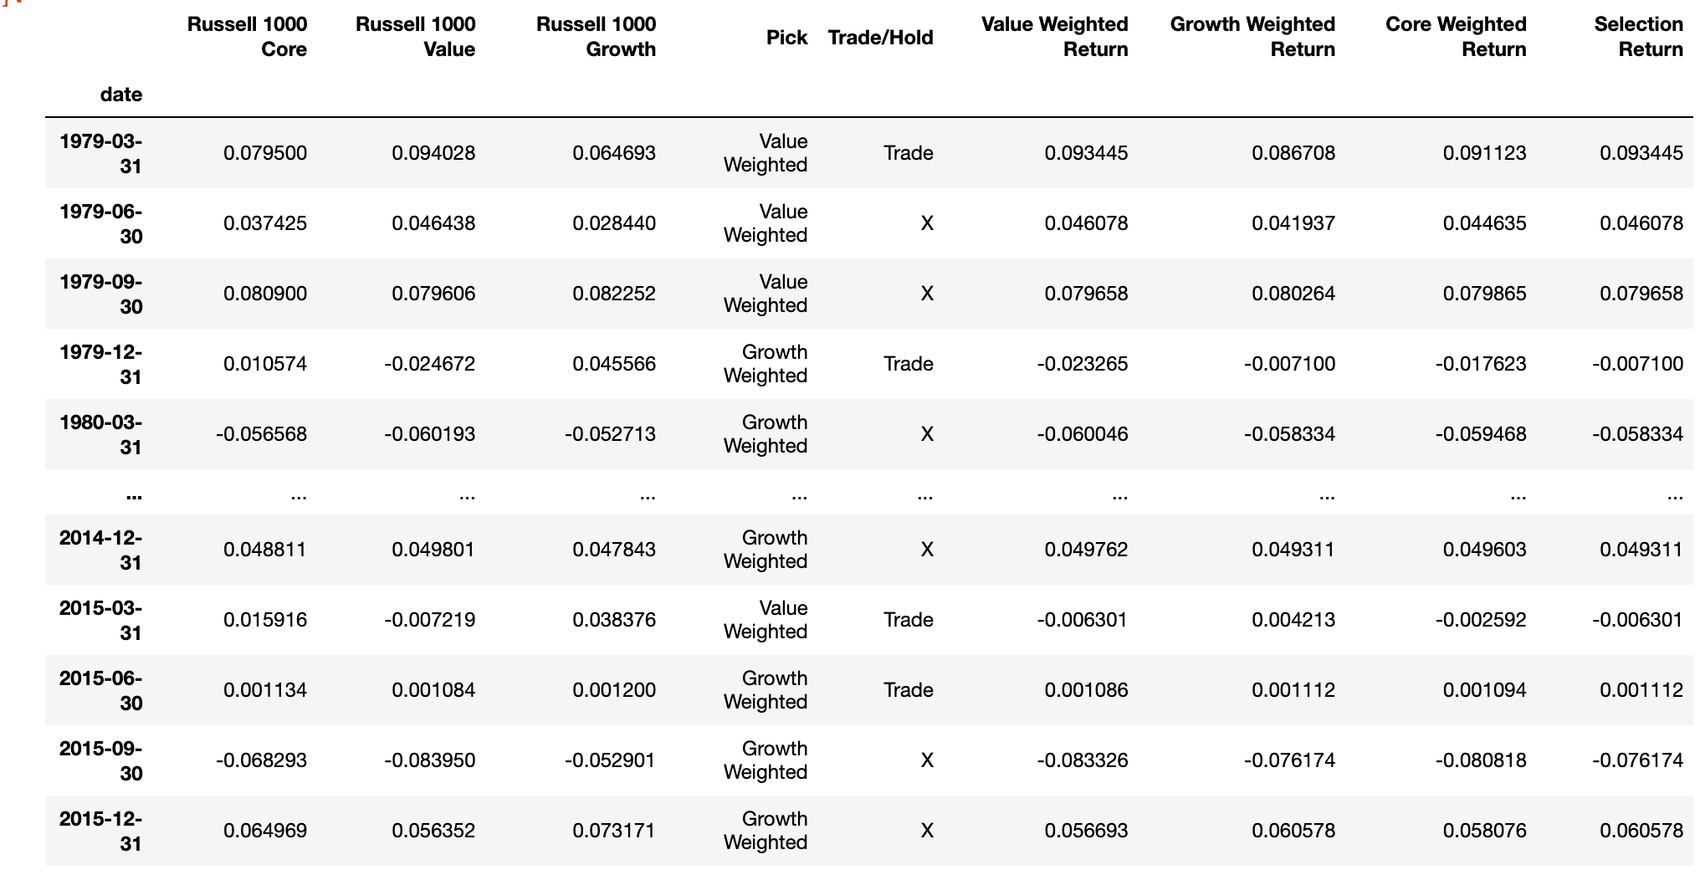
Momentum – Weighted Index Overview
The quarterly returns of each index are shown under their respective names.
The Pick column contains the name of the portfolio associated with the index with the highest return in the last period.
I defaulted the first pick to the Value Weighted.
The Trade/Hold column is a flag, which checks the previous month’s pick.
If it is not the same as the current month pick, a Trade flag is created.
The “weighted return” columns calculate the quarterly return based on the chosen portfolio weight of the portfolio listed in the column header.
The Selection Return column check the pick column, then the appropriate weighted return column, and the returns for the strategy’s chosen portfolio.

Slide 19
Momentum – Weighted Index Overview
This is a flow diagram showing how the model chooses its investment and the selection return values are reached.

Slide 20
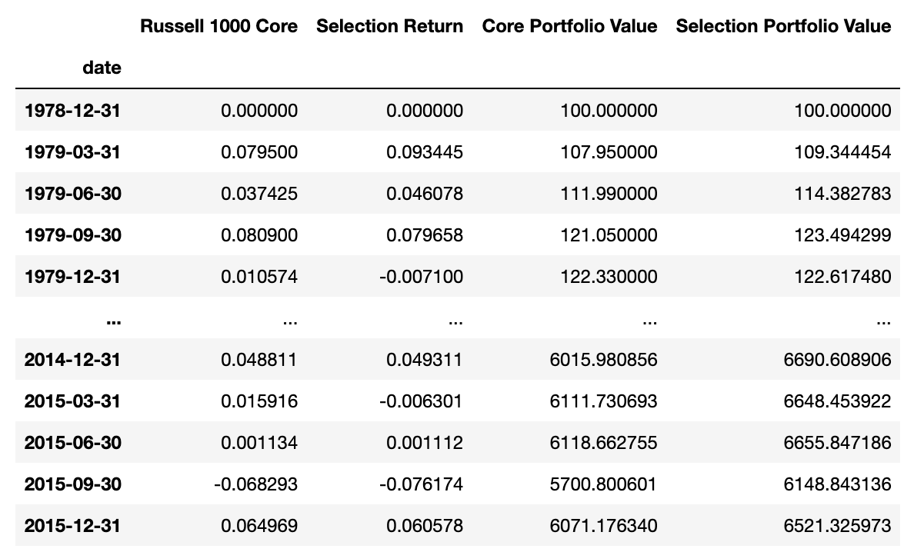
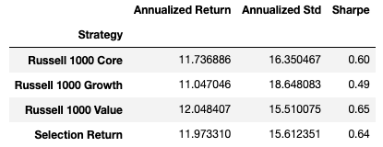
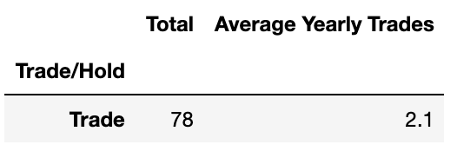
Momentum - Weighted Index Stats
Here I have provided a tabular representation of the strategy’s results. Including Annualized Return, Standard Deviation, Sharpe Ratio, Total trades over period, and average number of trades per year.

Slide 21
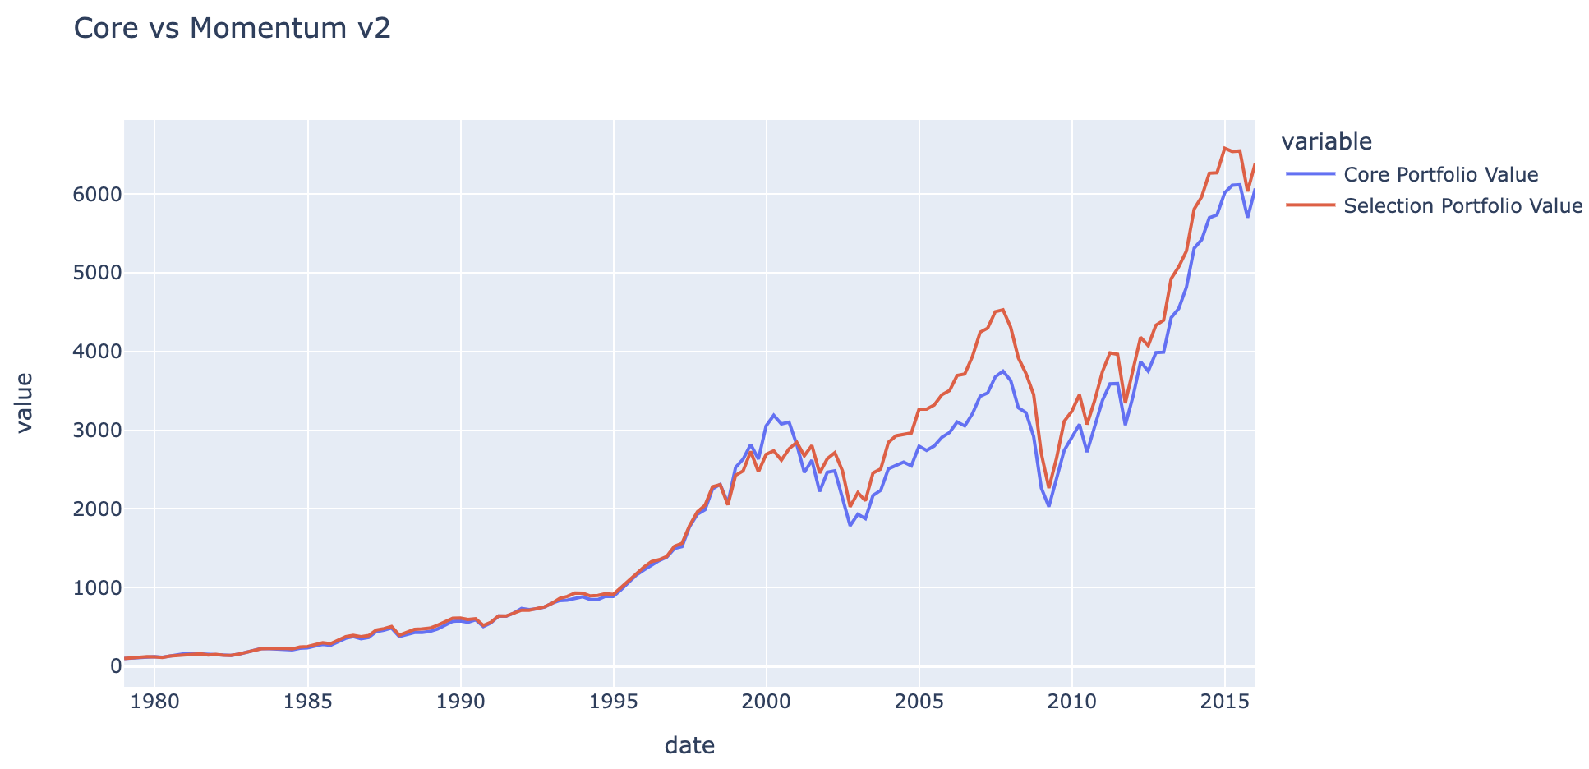
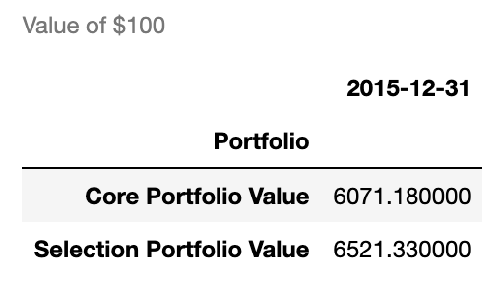
Core vs Momentum - Weighted Index Strategy Value of 100
Here, I have provided a line plot comparing the value of $100 for a portfolio that held the Russell 1000 Core over the period, and a portfolio holding the strategy’s selected index.

Slide 22
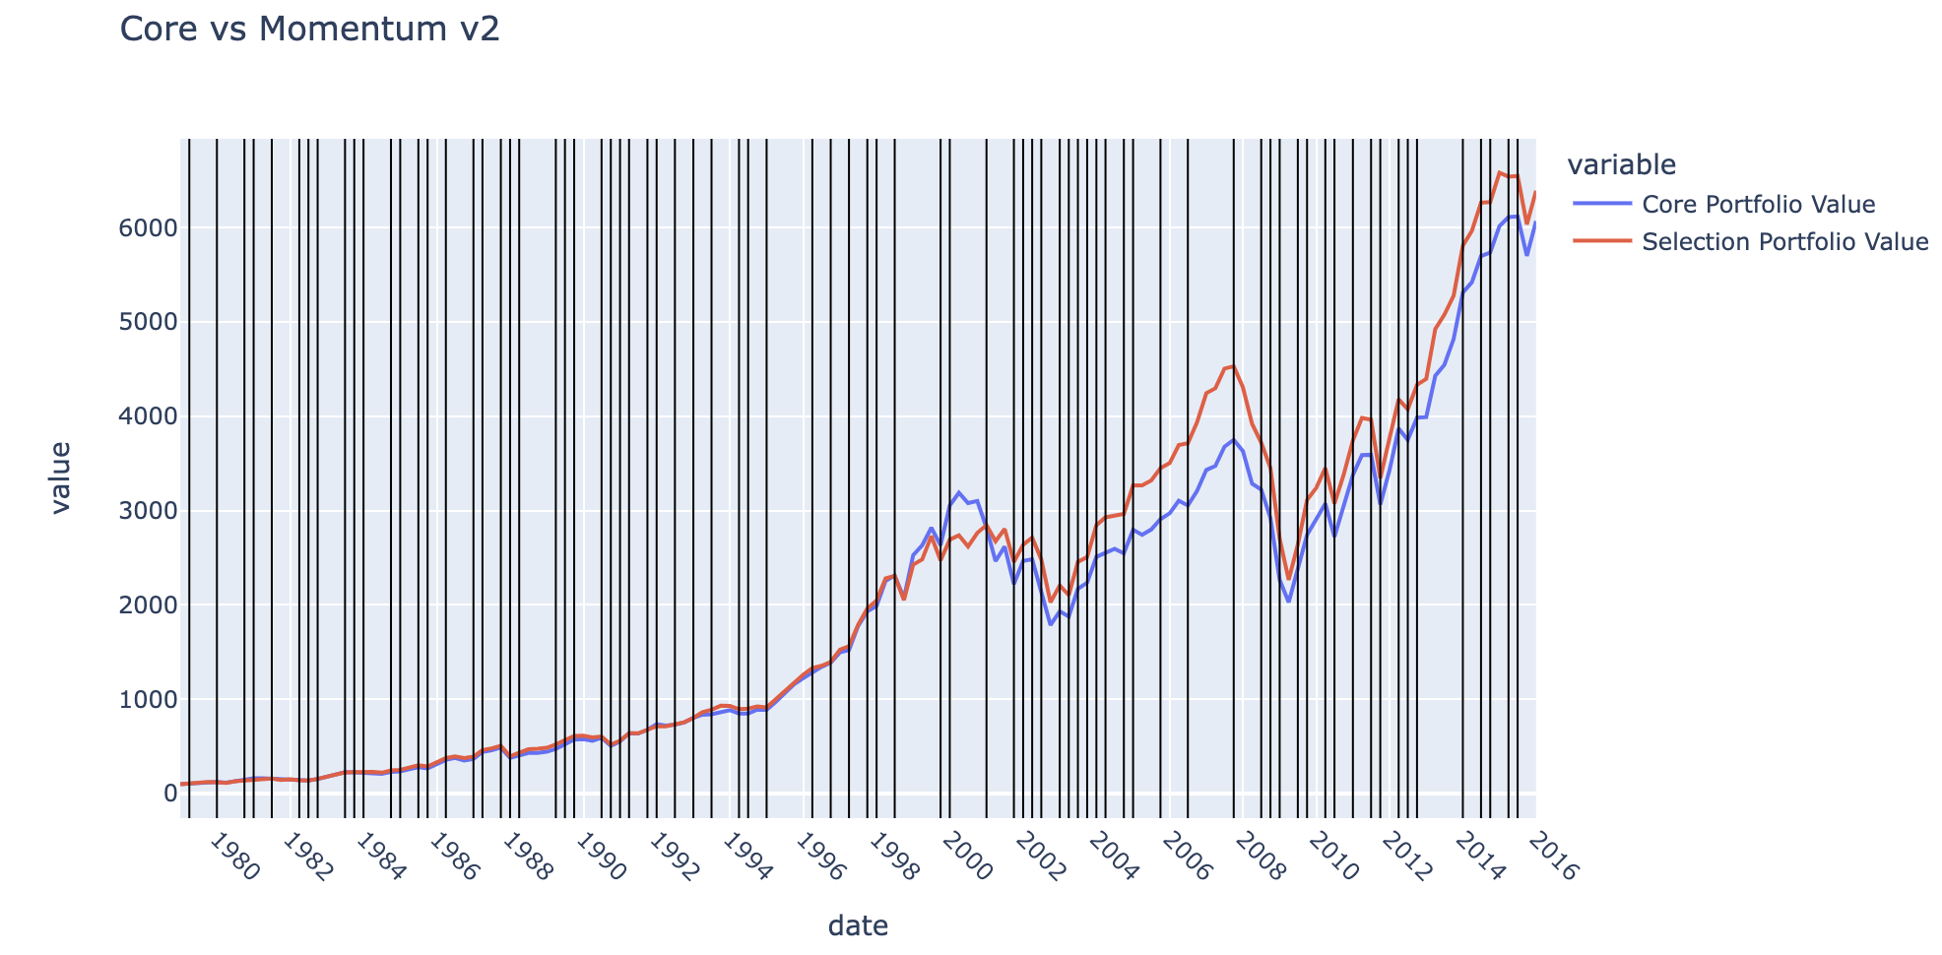
Core vs Momentum - Weighted Index Strategy Value of 100 w/ Trade Lines
The table presented here shows the change of a $100 Portfolio, with an overlay of trade flags. Each black vertical line represents when a trade would occur.
I did not find this table especially useful for this time series but believe it might have value for shorter horizons.

Slide 23
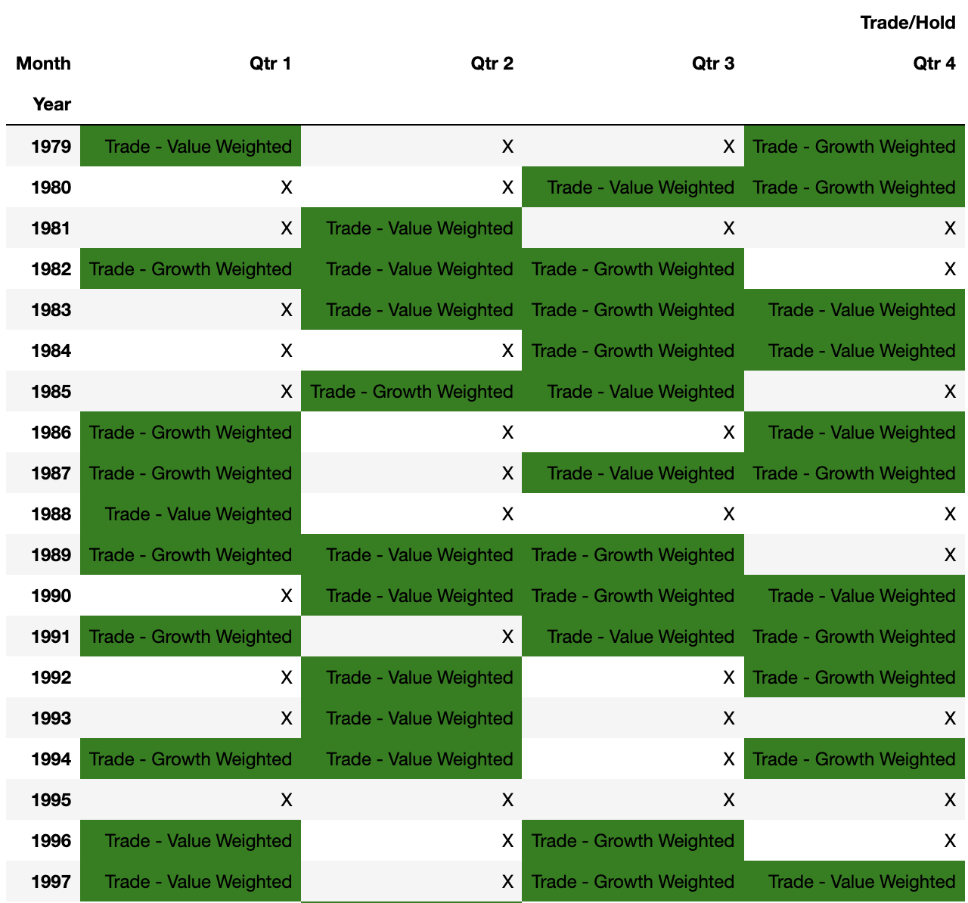
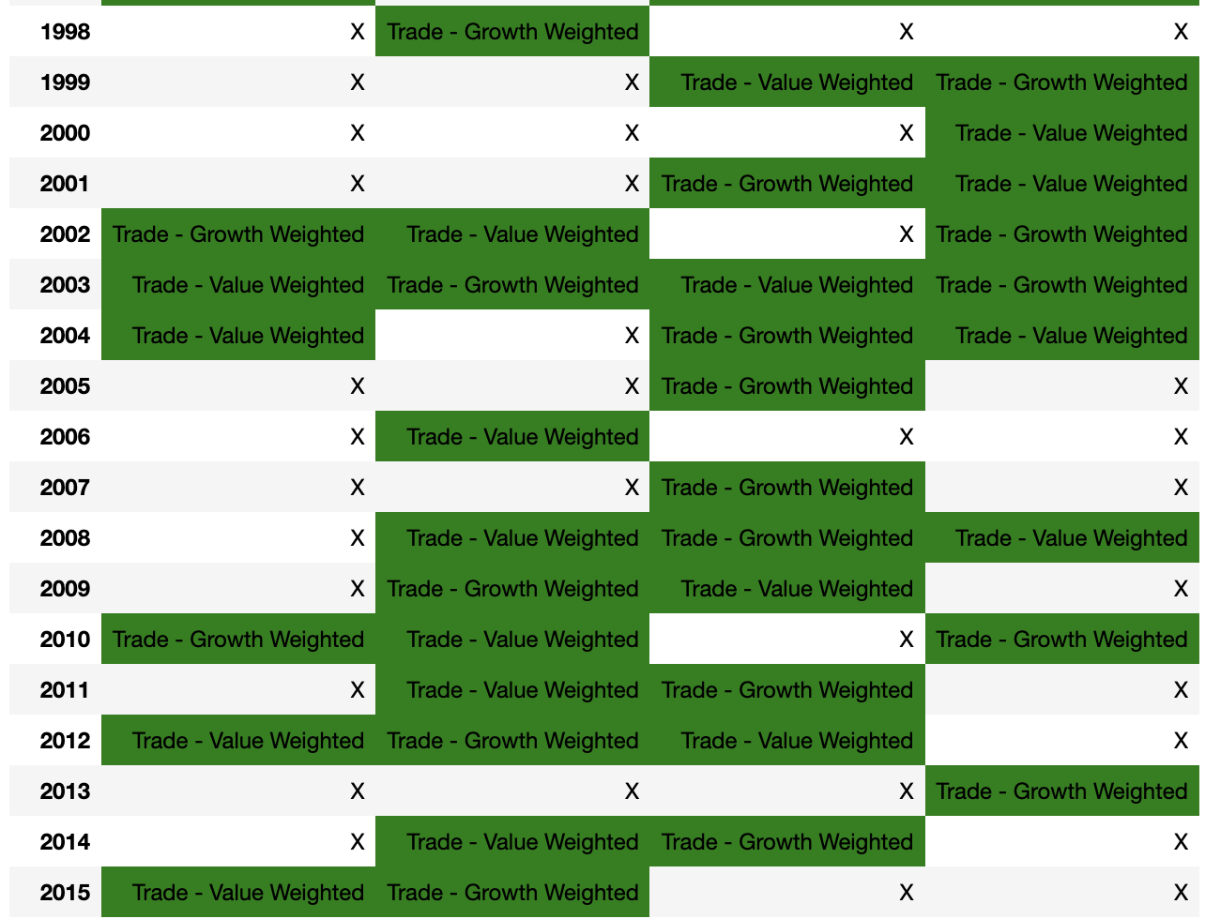
Momentum – Weighted Index Trade Schedule
This is a visual representation of when trades would occur over the period. Years are along the left side, with quarters across the top. Along with a “Trade” flag, it shows which portfolio should be invested in at the beginning of each quarter. These cells are shaded green. If no trade is to occur, the cell only contains the letter “X”

Slide 24
Momentum Weighted Index Portfolios- Summary
This strategy succeeded in beathing the Russell 1000 Core.
As shown on slide 19, the strategy resulted in slightly higher returns, with lower risk, resulting in a higher Sharpe Ratio.
The Weighted Momentum strategy resulted in a portfolio value of ~$6521 vs the Core portfolio value of ~$6071, a gain of about $450.
This does not include any expenses from the 78 trades over the period.
Creating weighted portfolios based on the indexes, allows for better risk adjusted returns, but there are expenses (not calculated here) to keep in mind when comparing a buy and hold strategy to an active one.

Slide 25
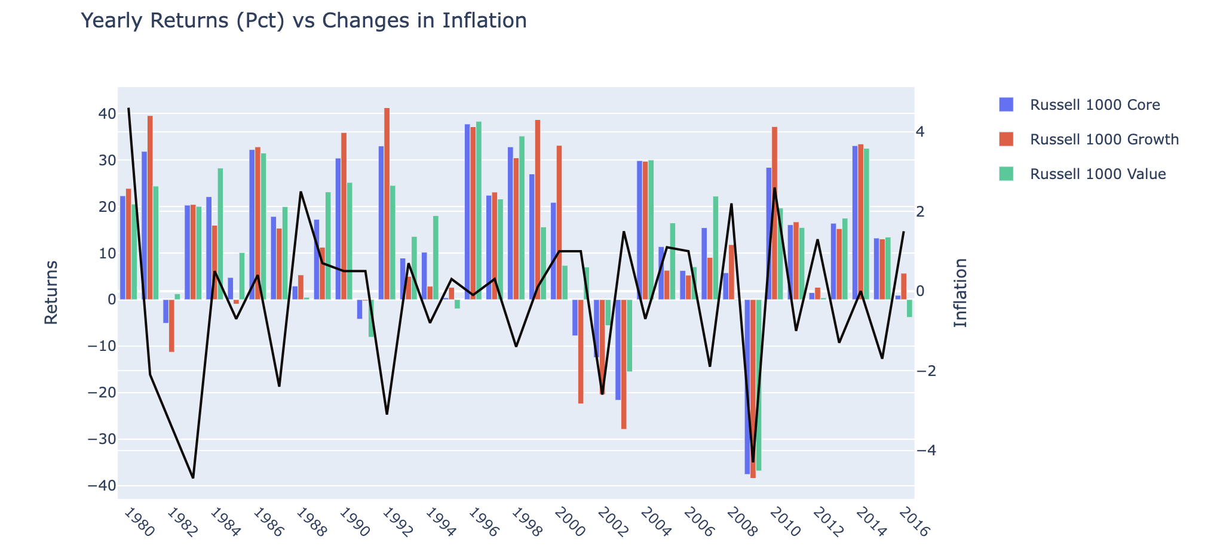
Indicator Based Selection – Prep - Yearly Index Returns vs Inflation
There appears to be negative correlation with changes in inflation, but it appears to be coincidental.

Slide 26
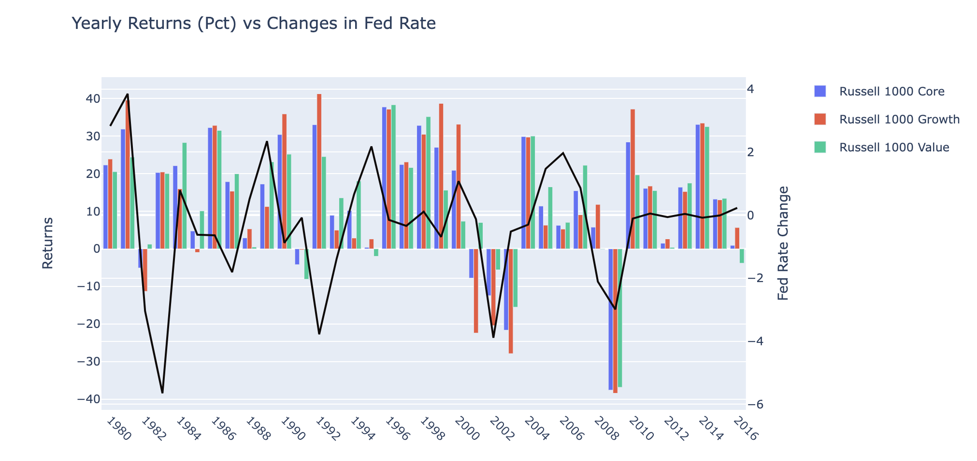
Indicator Based Selection – Prep - Yearly Index Returns vs Fed Rate
All indexes appear to move with fed rates to some degree, although at times they move in opposite directions.

Slide 27
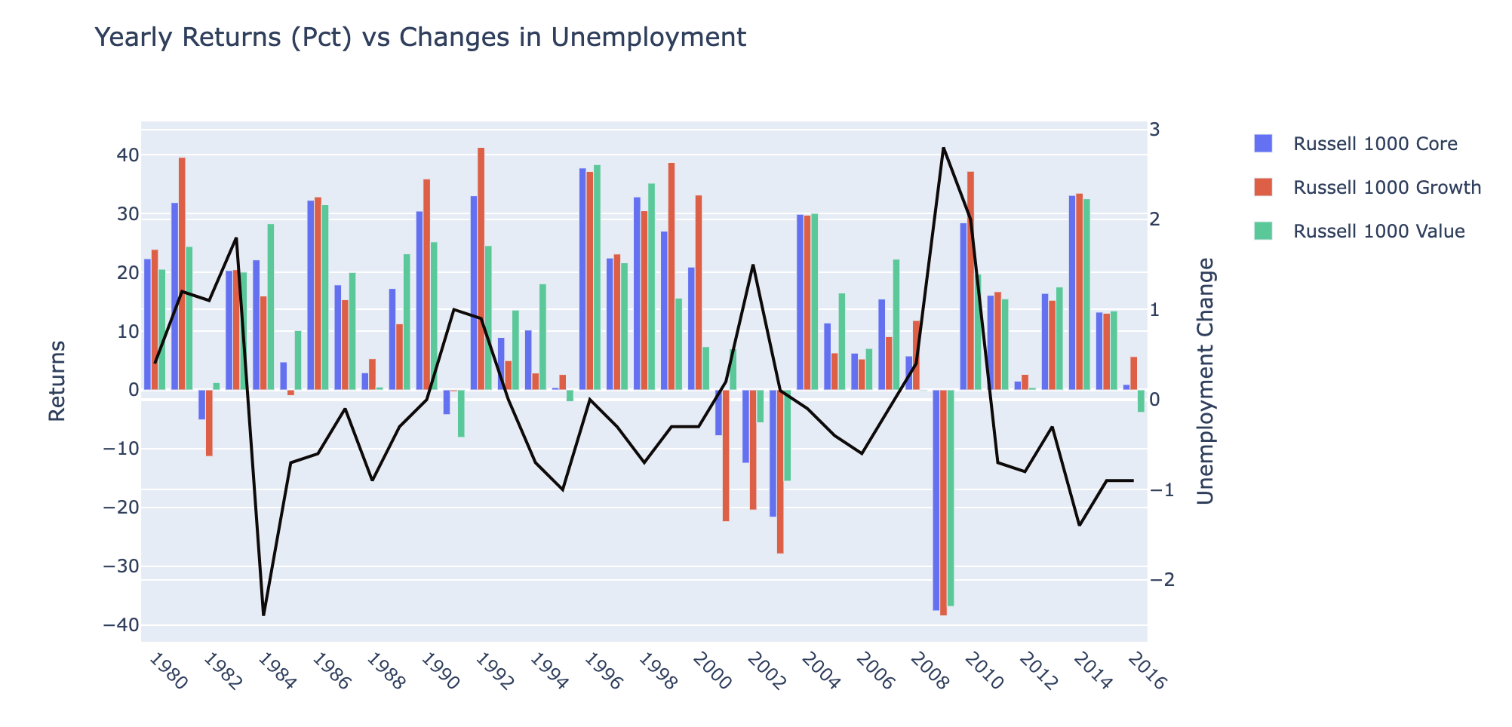
Indicator Based Selection – Prep - Yearly Index Returns vs Unemployment
There is a clear negative correlation between the indexes and unemployment.
Unfortunately, the indexes appear to be correlated enough that a chart such as this makes it hard to identify any opportunities. I will instead calculate correlation coefficients for the data.

Slide 28
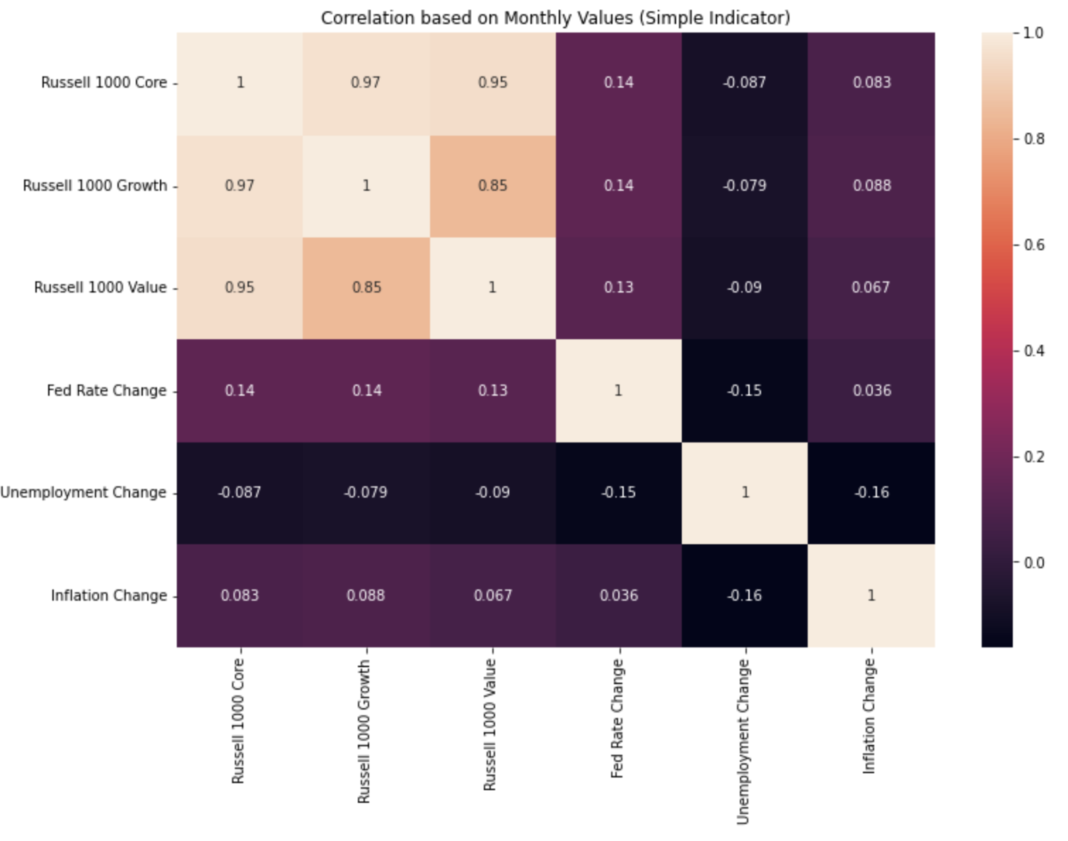
Indicator Based Selection – Prep - Indicator Correlation - Monthly
Based on the available monthly data
Core is highly correlated to both Growth and Value, but Value and Growth appear to be able to provide some diversification benefits to each other.
Growth stocks are expected to outperform slightly during times of rising inflation
Value stocks may be able to provide a hedge during times of falling inflation.
Value stocks should outperform during times of falling unemployment
Growth stocks should provide a hedge during times of rising unemployment.
All strategies behave similarly to changes in Interest Rates – This is likely negligible, but Value appears to have a small edge in times of falling fed rates.

Slide 29
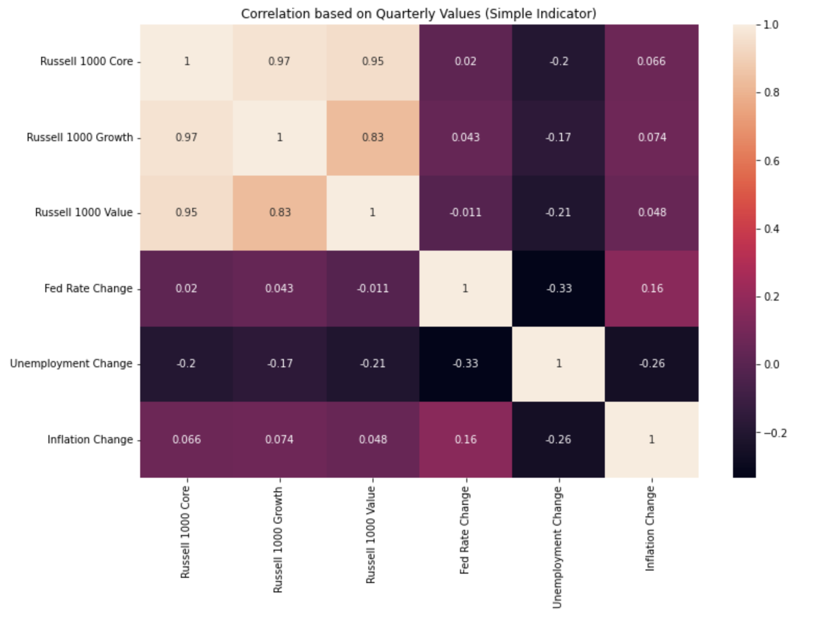
Indicator Based Selection – Prep - Indicator Correlation - Quarterly
The Quarterly correlation data mostly confirms my previous observations with one exception:
Quarterly, Value appears to be a much stronger pick in times of negative fed rate changes, going from a low positive correlation, to a low negative correlation.

Slide 30
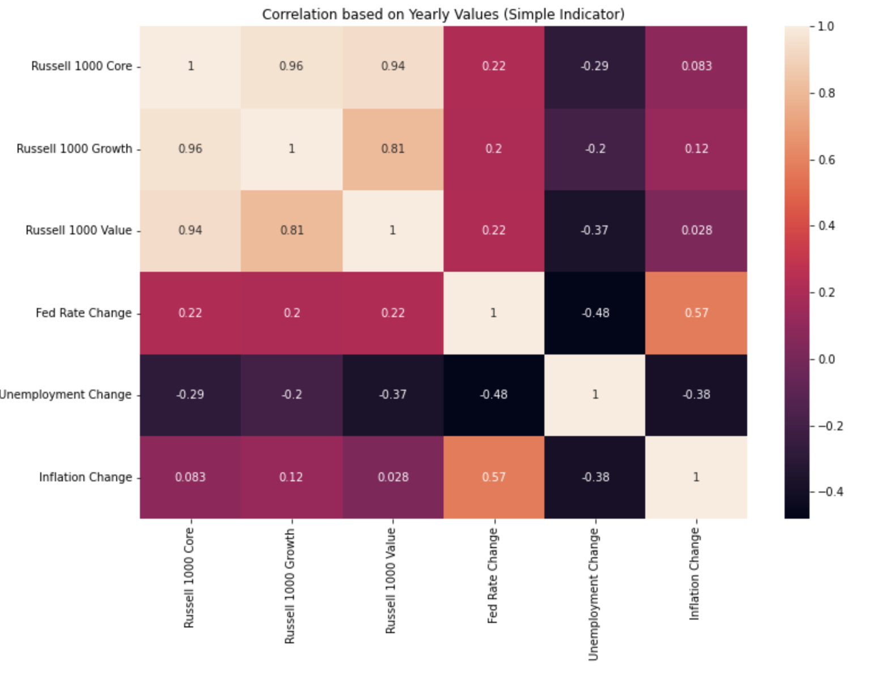
Indicator Based Selection – Prep - Indicator Correlation - Yearly
I have no new observations based on the yearly correlation data. I will note, though, that the fed rate correlations are now more in line with the monthly values.

Slide 31
Portfolio Update
I have decided to no longer use the Core Weighted Portfolio.
I believe Core and Value to be too positively correlated for a larger Core allocation to provide meaningful gains or diversification.
If Core is the favored index, the strategies will now point to the value portfolio.

Slide 32
Indicator Based Selection – Strategy
The Strategy:
The Indicator Based selection strategy assigns each portfolio a value (1 for Value Weighted and -1 for Growth) and assigns these values to a flag depending on direction.
For example if unemployment falls (is < 0), the unemployment flag, will be assigned a value of 1 as a result of Values higher negative correlation with that indicator. If it rises, it will be assigned a value of -1. These values are based on the correlations noted in previous slides.
The values are then summed into a Flag field, and used to decide which portfolio to invest in.
If the flag sum is negative, Growth received more flags and will be considered in favor. If it is positive, the same is true for Value. 0 originally pointed at the Core Weighted portfolio, but this was removed, and replaced with Value as previously noted.
This model looks back one period(quarter), determines which portfolio has been flagged, and invests in it.
The economic indicators used for this strategy are:
Unemployment
Fed Funds Rate
Inflation

Slide 33
Why not percentage changes?
While building this model, I did consider using percentage changes in the indicators instead of the differences. I decided against this for two reasons.
Some indicators can and have reached 0. This will cause mathematical issues for the model when attempting to determine a month over month percentage change.
When indicators are near zero, many changes can be overstated. For example, an indicator shifting from .1 to .2 likely won’t make much difference but will be weighted heavily as a 100% increase.

Slide 34
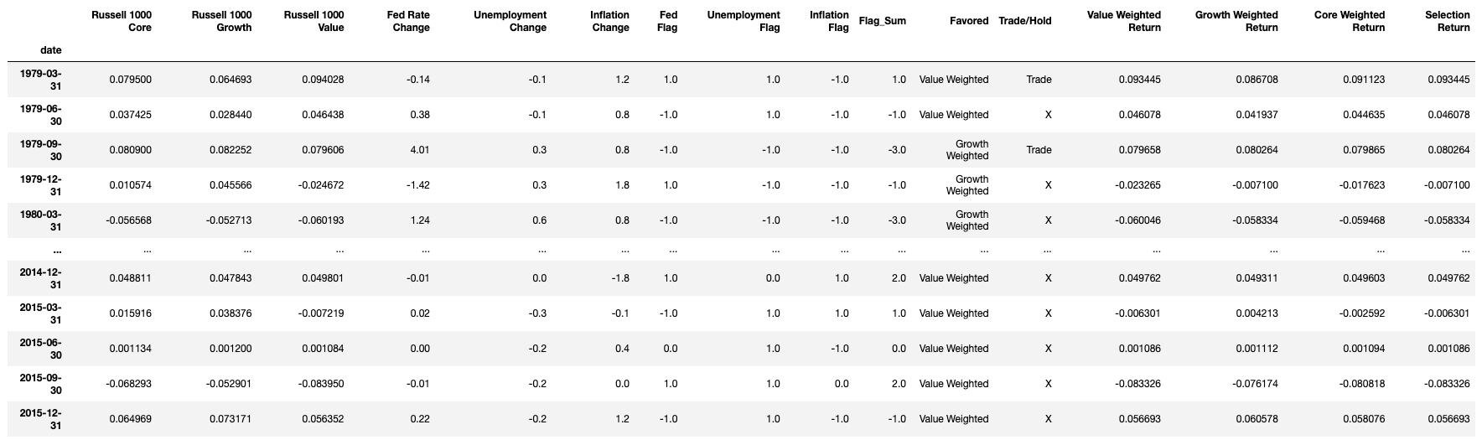
Indicator Selection Overview
The quarterly returns of each index are shown under their respective names.
The Flag_Sum field aggregates all flag values into a sum value.
The Favored column contains the name of the favored portfolio based on the Flag_Sum field.
The Trade/Hold column is a flag, which checks the previous month’s pick.
If it is not the same as the current month pick, a Trade flag is created.
The “weighted return” columns calculate the quarterly return based on the chosen portfolio weights of the portfolio listed in the column header.
The Selection Return column checks the pick column, then the appropriate weighted return column, and the returns for the strategy’s chosen portfolio.

Slide 35
Indicator Selection Overview
This is a flow diagram showing how the model chooses its investments and the selection return values are reached.

Slide 36
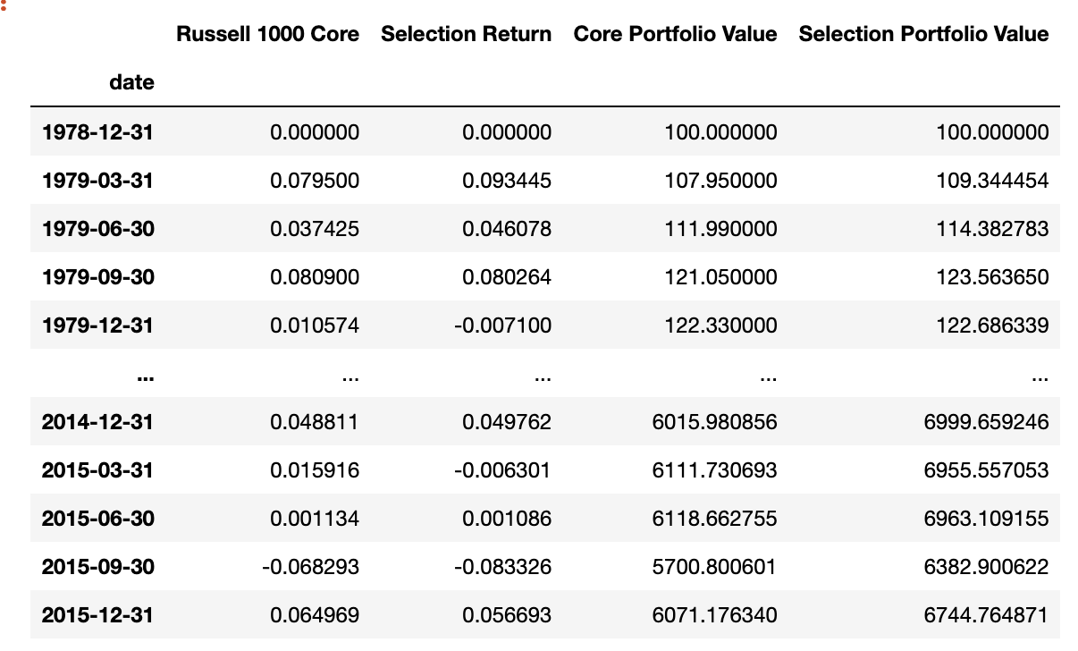
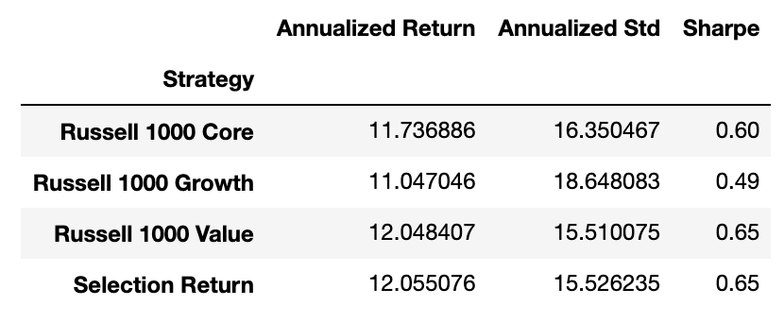
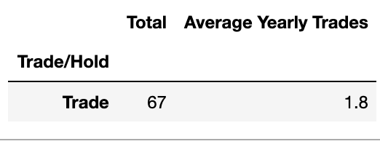
Indicator Selection Stats
Here I have provided a tabular representation of the strategy’s results. Including Annualized Return, Standard Deviation, Sharpe Ratio, Total trades over period, and average number of trades per year.

Slide 37
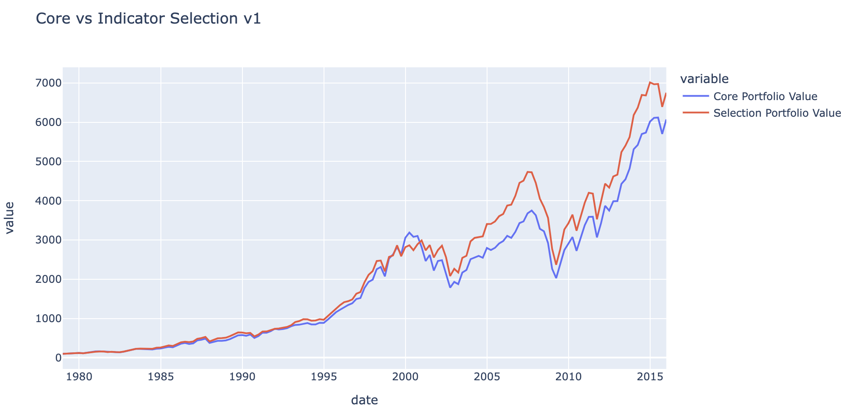
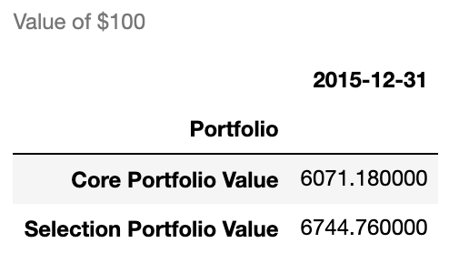
Core vs Indicator Selection Strategy
Here I have provided a line plot comparing the value of $100 for a portfolio that held the Russell 1000 Core over the period, and a portfolio holding the strategy’s selected index.

Slide 38
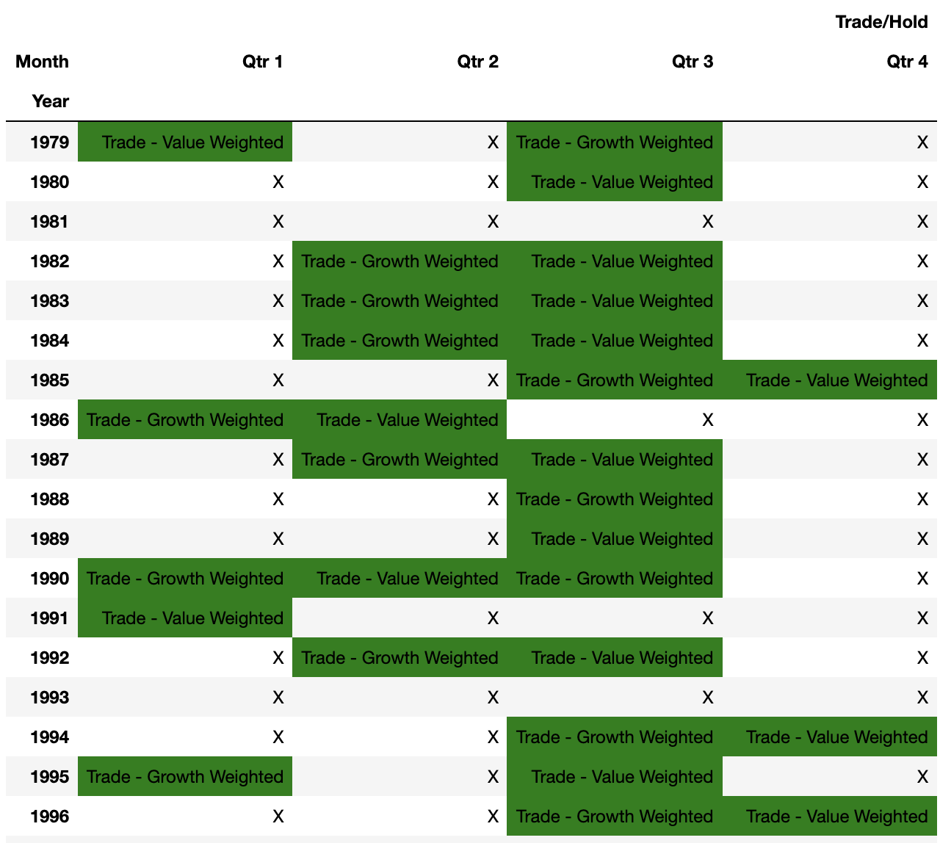
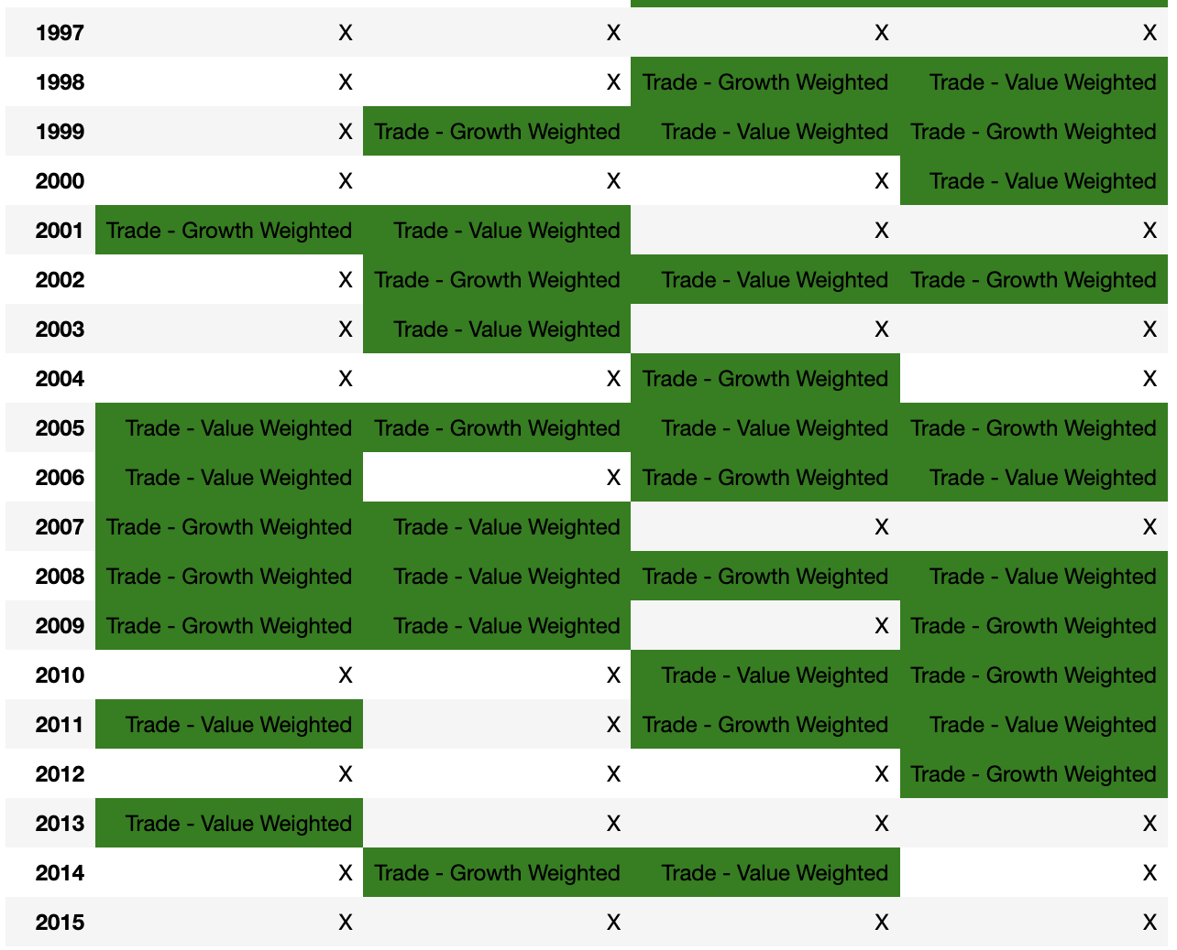
Indicator Selection - Trade Schedule
This is a visual representation of when trades would occur over the period. Years are along the left side, with quarters across the top. Along with a “Trade” flag, it shows which portfolio should be invested in at the beginning of each quarter. These cells are shaded green. If no trade is to occur, the cell only contains the letter “X”

Slide 39
Indicator Based Selection – Summary
This strategy succeeded in beating the Russell 1000 Core and Value.
As shown on slide 36, the strategy resulted in higher returns, with lower risk (compared to core), resulting in a higher Sharpe Ratio. The Sharpe Ratio for the strategy and the Value index are almost the same.
The Indicator Selection strategy resulted in a portfolio value of ~$6744 vs the Core portfolio value of ~$6071, a gain of about $673.
This does not include any expenses from the 67 trades over the period.
Using economic indicators appears to be a better way to forecast returns than momentum, over the time period chosen.

Slide 40
Indicator(Leading) Based Selection – Strategy
This strategy is the same as the Indicator Based Selection strategy with two exceptions.
The indicators:
Consumer Confidence Index
Housing Starts
Manufacturing Employment
Indicator flags will no longer be constrained to 1, -1

Slide 41
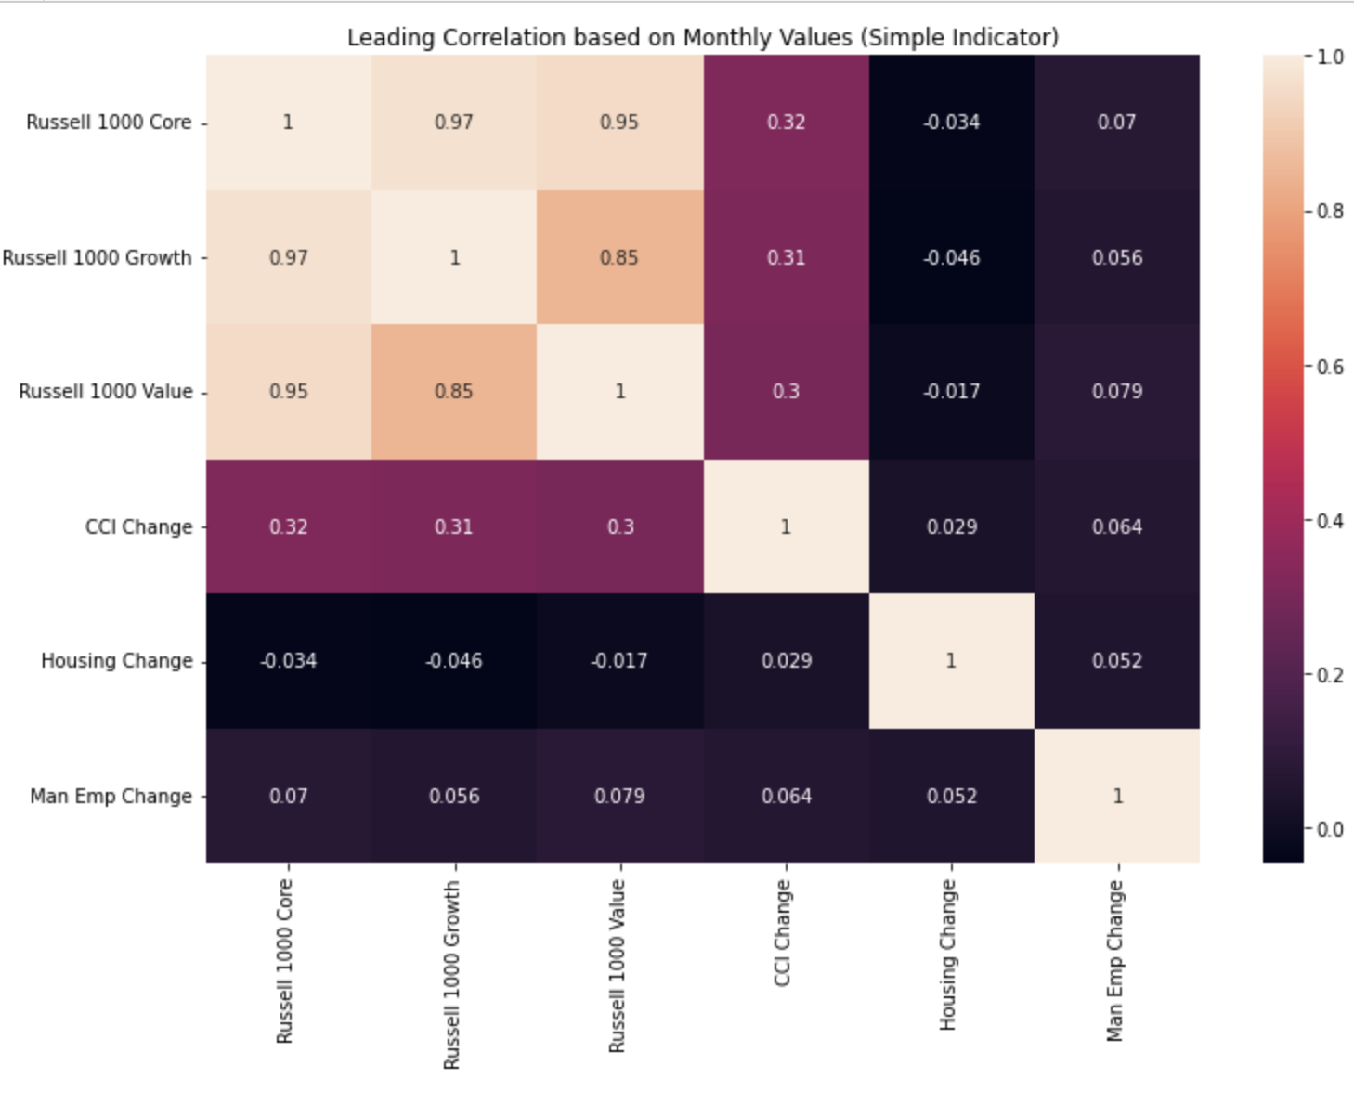
Leading Indicator Correlation - Monthly
Growth appears to outperform in times of falling housing starts.
When housing starts are rising, Value should act as a hedge since all indexes are negatively correlated.
Consumer Confidence appears to affect all indexes the same, with a slight edge to Value in times of falling CCI.
Value appears to respond well to rising manufacturing employment, while growth can be used as a hedge when manufacturing employment is falling.

Slide 42
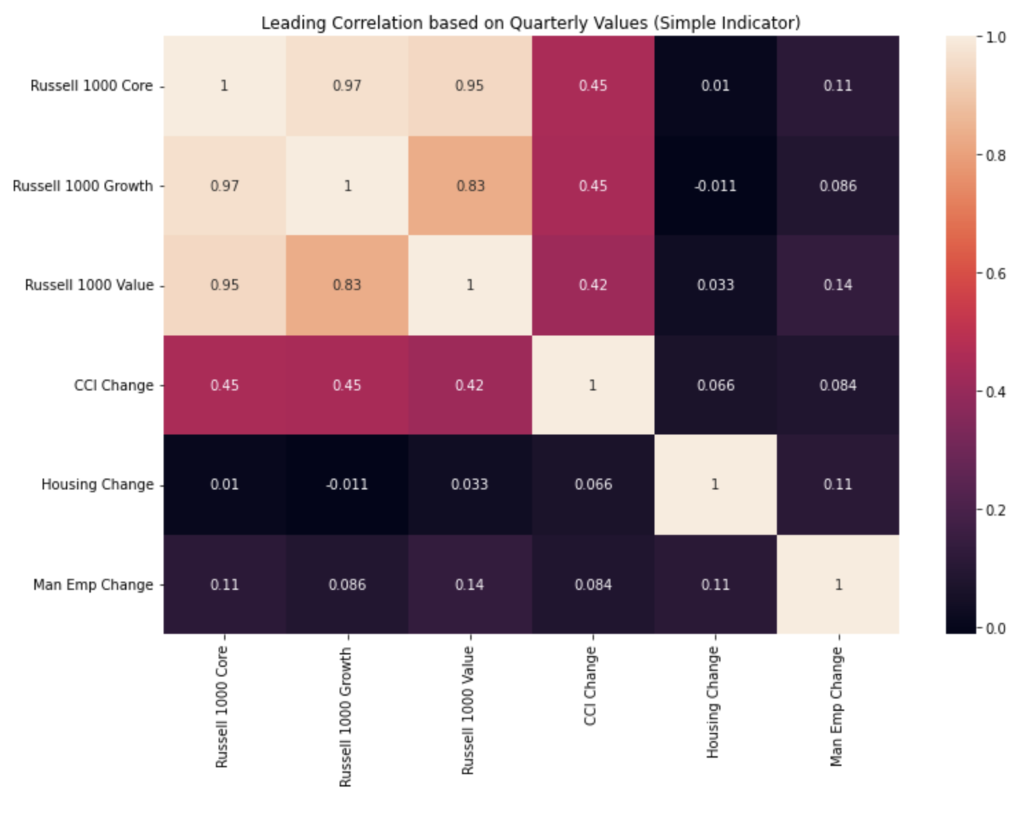
Leading Indicator Correlation - Quarterly
Quarterly, Value appears to do very well comparatively when housing starts are rising.

Slide 43
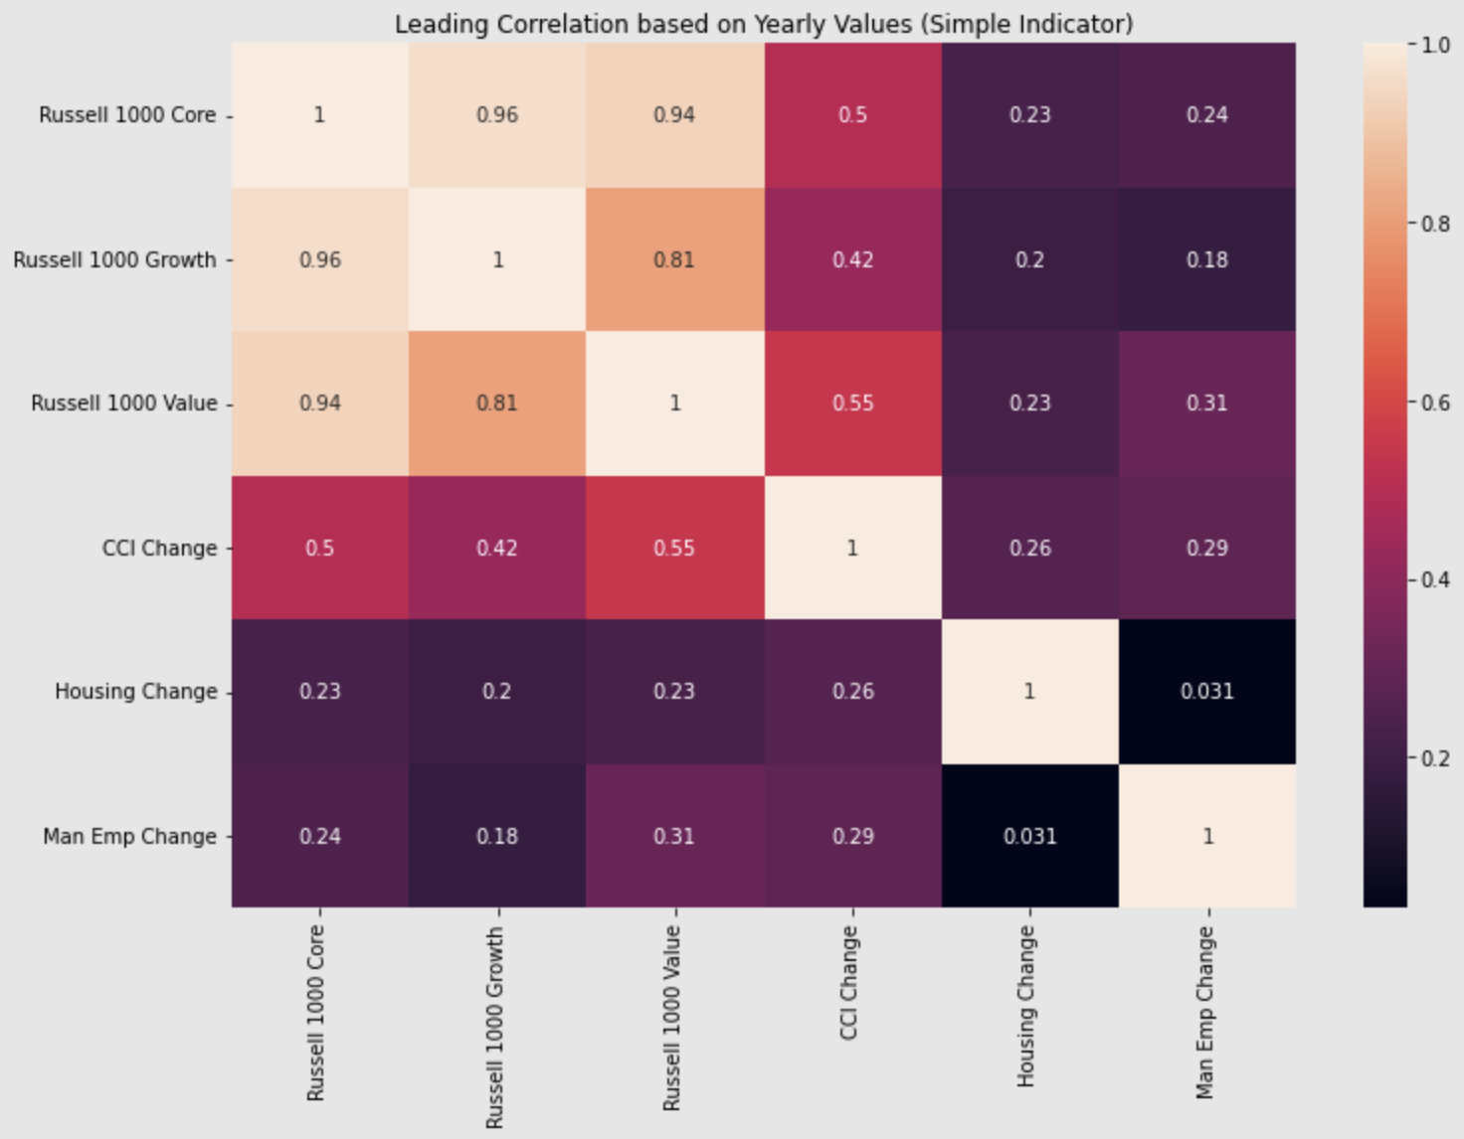
Leading Indicator Correlation - Yearly
Yearly, all indexes appear to have a similar response to Housing Starts.
Value and Growth seem to outperform during times of rising CCI.

Slide 44
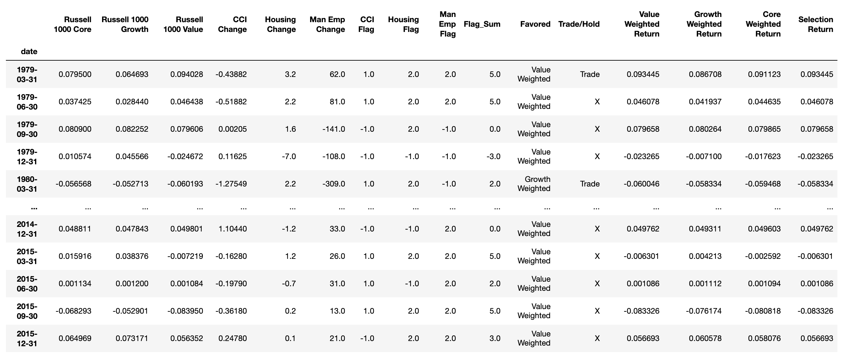
Indicator(Leading) Selection Overview
The quarterly returns of each index are shown under their respective names.
The Flag_Sum field aggregates all flag values into a sum value.
The Favored column contains the name of the favored portfolio based on the Flag_Sum field.
The Trade/Hold column is a flag, which checks the previous month’s pick.
If it is not the same as the current month pick, a Trade flag is created.
The “weighted return” columns calculate the quarterly return based on the chosen portfolio weights of the portfolio listed in the column header.
The Selection Return column checks the pick column, then the appropriate weighted return column, and the returns for the strategy’s chosen portfolio.

Slide 45
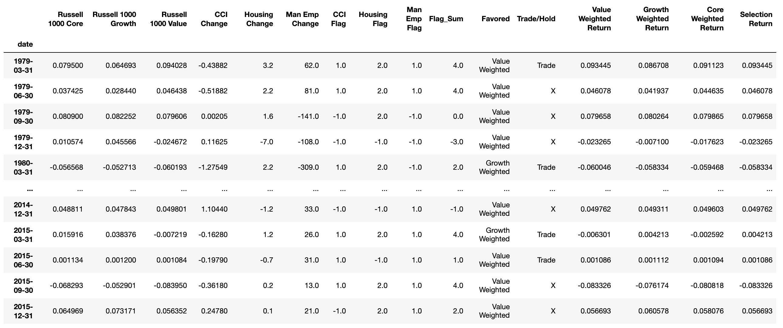
Indicator(Leading) Selection Overview
This is a flow diagram showing how the model chooses its investments and the selection return values are reached.

Slide 46
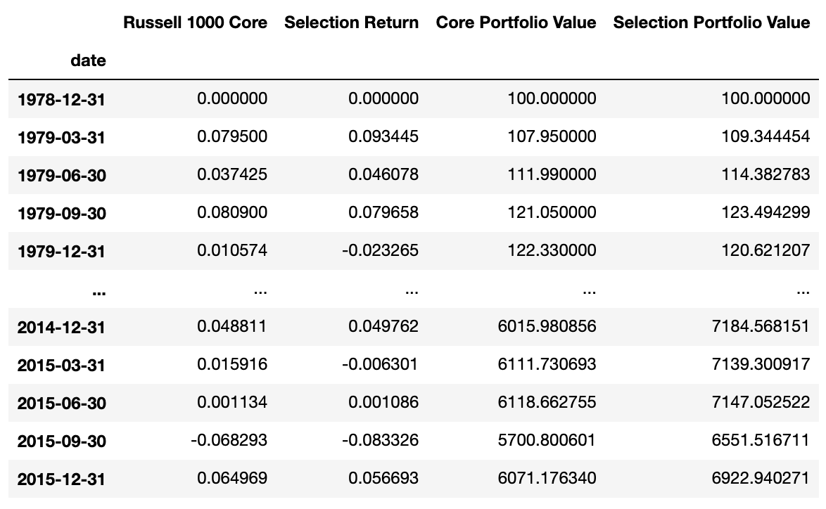
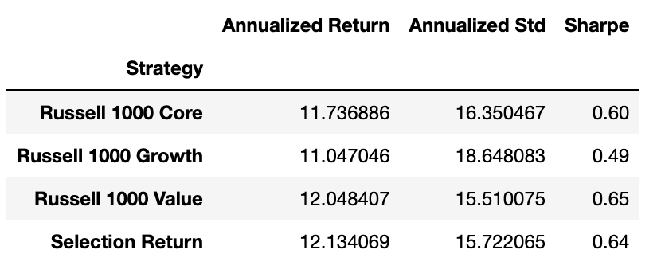
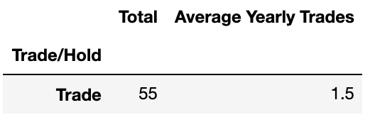
Indicator (Leading) Stats
Here I have provided a tabular representation of the strategy’s results. Including Annualized Return, Standard Deviation, Sharpe Ratio, Total trades over period, and average number of trades per year.

Slide 47
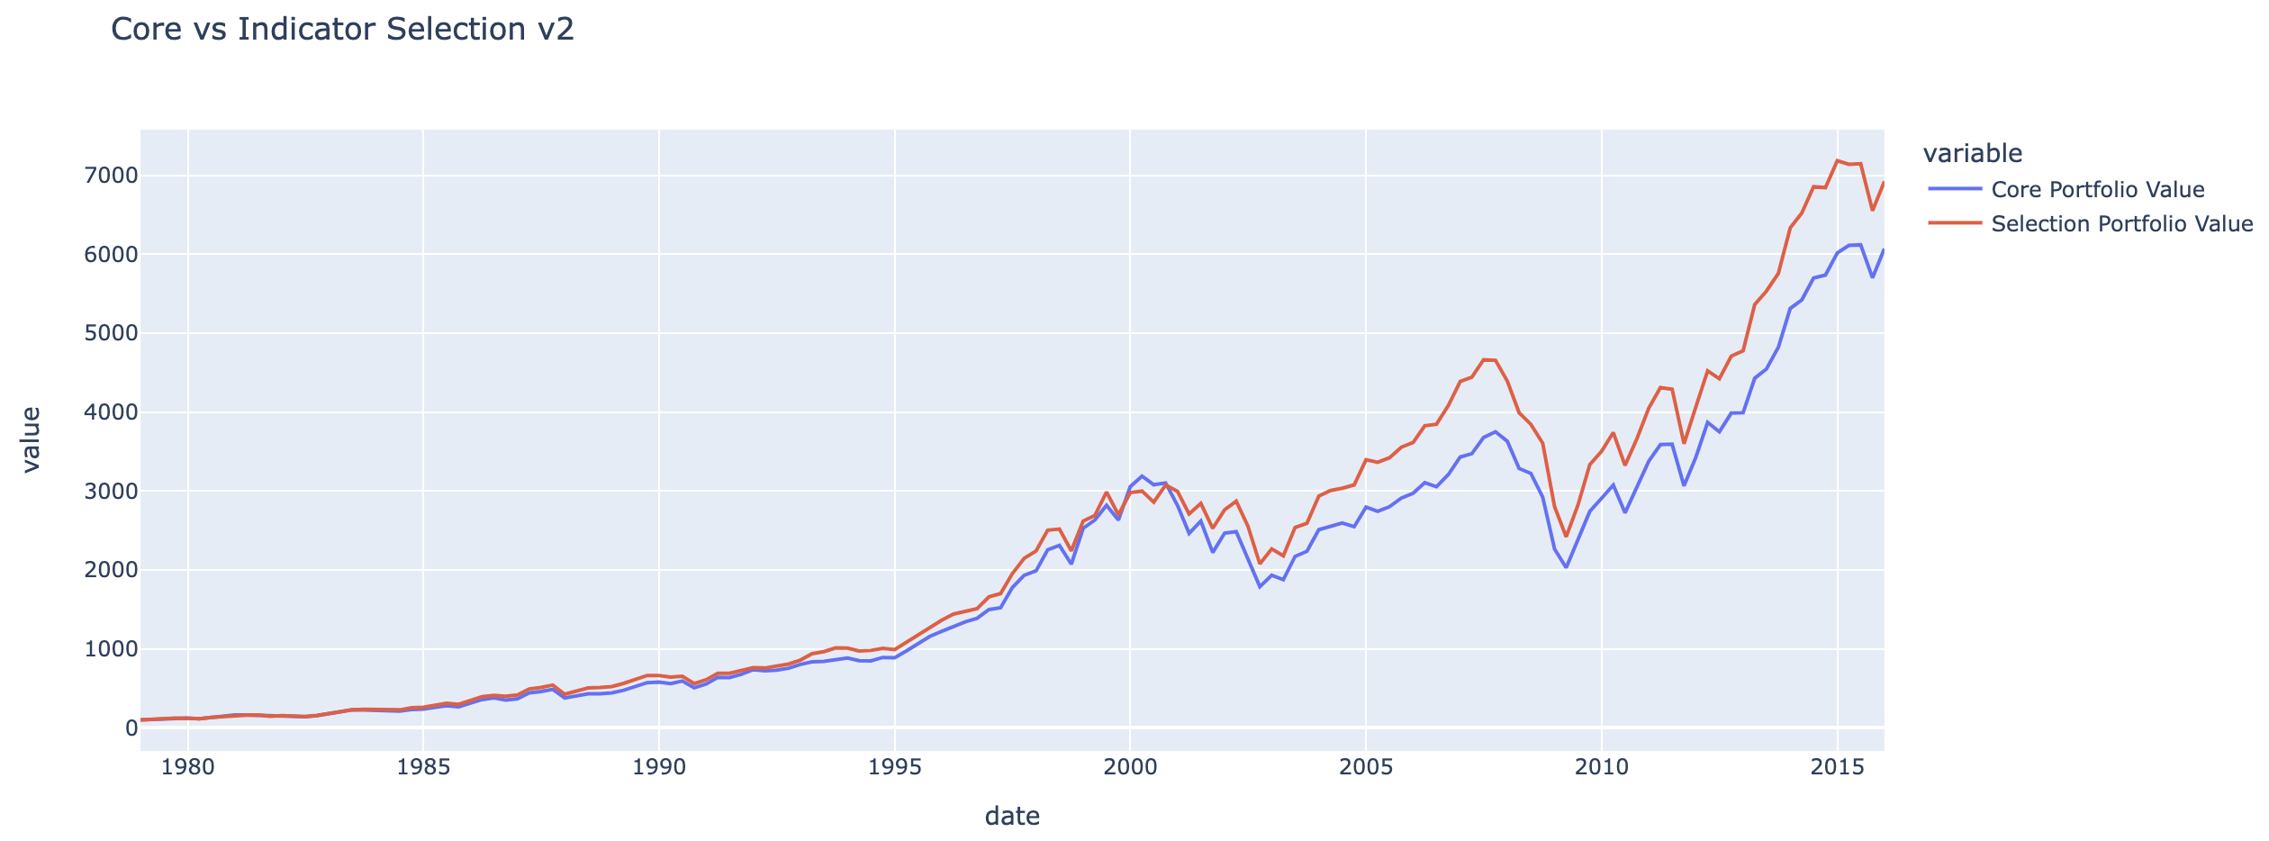
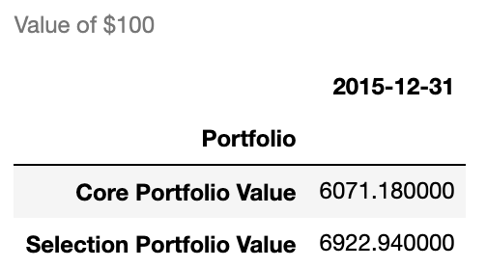
Core vs Indicator Selection (Leading) Strategy
Here, I have provided a line plot comparing the value of $100 for a portfolio that held the Russell 1000 Core over the period, and a portfolio holding the strategy’s selected index.

Slide 48
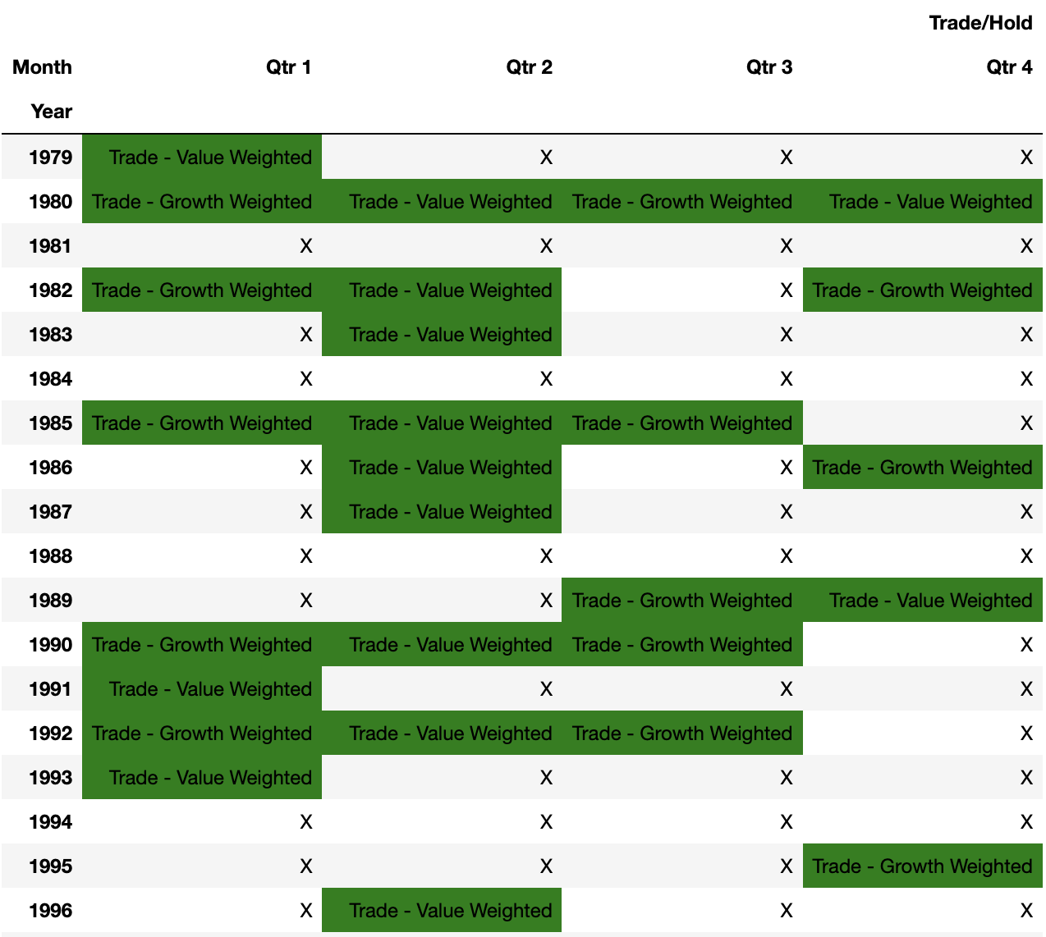
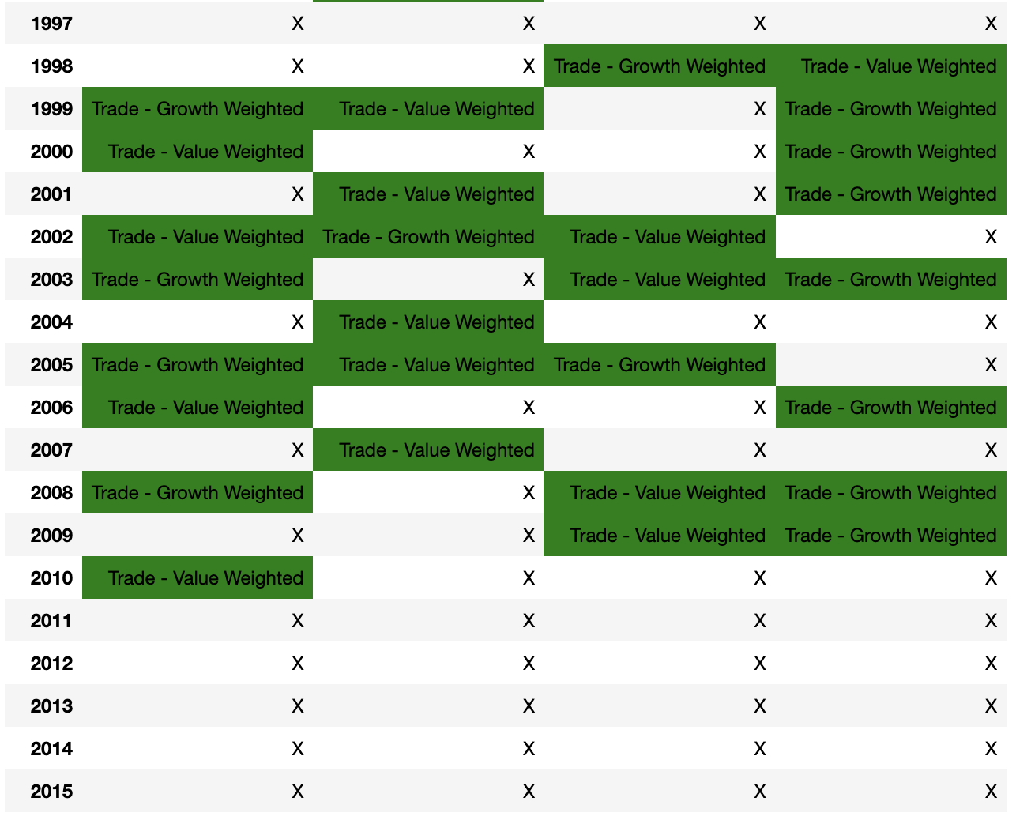
Indicator Selection (Leading) - Trade Schedule
This is a visual representation of when trades would occur over the period. Years are along the left side, with quarters across the top. Along with a “Trade” flag, it shows which index should be invested in at the beginning of each quarter. These cells are shaded green. If no trade is to occur, the cell only contains the letter “X”

Slide 49
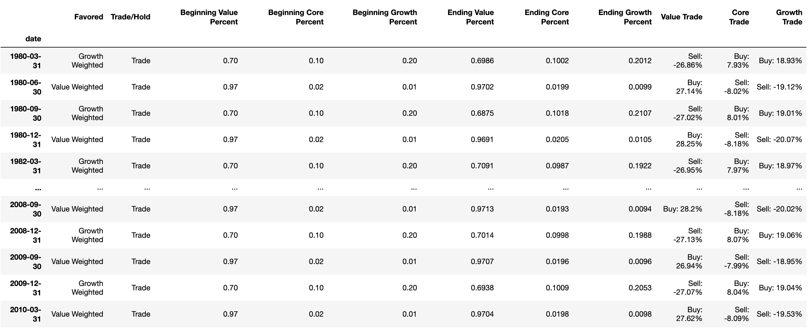
Indicator Selection(Leading) – Advanced Trade Schedule
I created a new view that will compare the expected beginning weight of the chosen portfolio to last quarters ending weight and advise how much of each index to buy/sell at the beginning of each quarter. This table can be expanded to show the dollar value of each index within the portfolio at any given time as well.

Slide 50
Indicator Selection(Leading) – Advanced Trade Schedule - Flow

Slide 51
Leading Indicator Based Selection – Summary
This strategy succeeded in beathing the Russell 1000 Core and Value.
As shown on slide 46, the strategy resulted in higher returns, with lower risk (compared to core) and slightly higher risk when compared to value.
The Indicator Selection strategy resulted in a portfolio value of ~$6922 vs the Core portfolio value of ~$6071, a gain of about $851.
This does not include any expenses from the 55 trades over the period.
Using what are considered to be “leading” indicators does appear to provide even better results than the indicators used previously.
I also double weighted some indicators based on what I perceived to be strengths. Two of these did result in stronger gains: The Housing Start Flag, and Manufacturing Employment flagged were double weighted when expecting a positive return for the Value Weighted portfolio.

Slide 52
Summary
The Indicator Selection (Leading) strategy is the highest performing strategy from a return standpoint.
It generates higher risk adjust returns than two of the indexes (and is very close to the third) with the fewest trades of any of the strategies.
That being said, this strategy still resulted in 55 trades that would not be required if buying and holding the Russell 1000 core.
The cost of trades, offset (or enhanced) by any tax benefits (liabilities) will truly determine if this strategy would outperform.
Assuming trade costs are fixed, larger portfolios might perform better under this strategy as costs become negligible.

Slide 53
Future Enhancements
Ways I believe the model(s) could be improved upon, given additional data and/or opportunity.
Consider Tax Burden Before Trades
If a gain is to be traded out of, estimate tax burden and returns up to the end of the current year, and only trade if return is greater.
Factor Weights
Create a more in-depth model that more accurately assesses a factor’s impact on return, and weight accordingly instead of only using direction.
This is somewhat done in the Indicator(Leading) Selection strategy, but it could be more systematic.
Loss Harvesting tracker
If a loss is to be traded out of, keep running yearly total, and calculate estimated tax benefit to reset after the 4th quarter of every year.
Consider Trade Costs Before Trades / Trade Cost Tracker
Calculate estimated trade cost vs return for remainder of year.
Track total trade cost within a given year, increasing with each executed trade and resetting to 0 at the start of a new year.
Emergency Flag
Flag any time period with abnormal indicator movements between longer periods.
Volatility indicator
I wanted to include volatility in my model but could not find data that fit within the time period.

